Slide 1
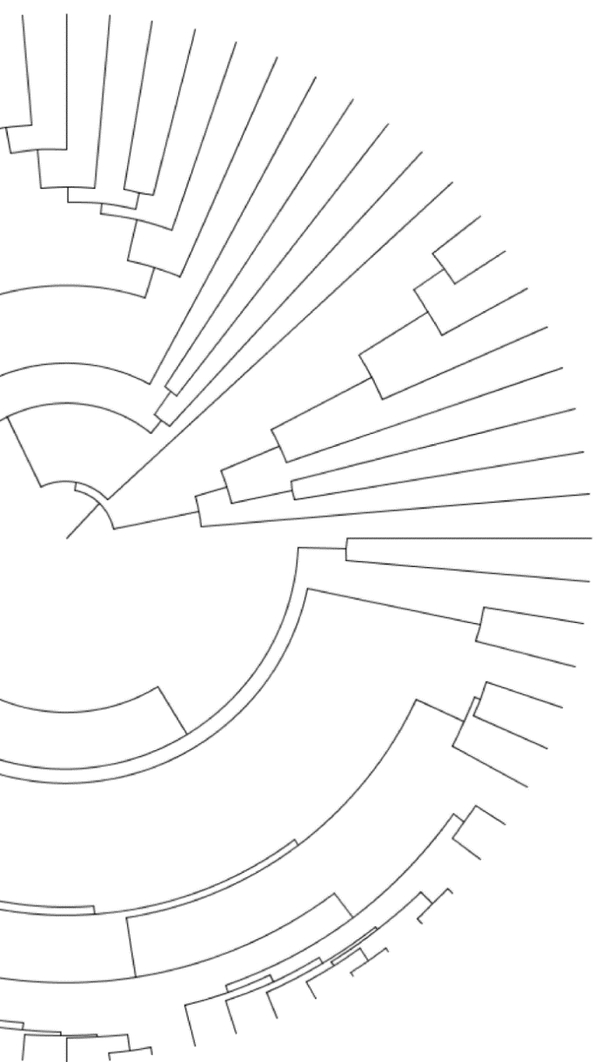


Quantifying and mitigating reference bias in comparative genomics
Gregg Thomas
gwct.github.io
Notes:
Hi everyone, my name is Gregg Thomas and I’m from the informatics group at Harvard. Today I’ll be talking about an important problem in comparative genomics when read mapping is used called reference bias.

Slide 2


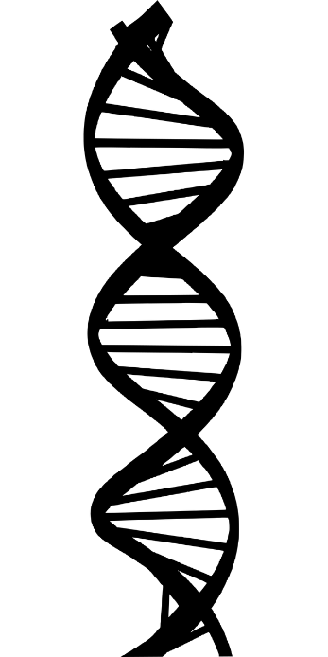


Genome sequencing has changed how we study biology
Allows the study of every aspect of DNA’s structure and variation
We can compare genomes to infer how they change over time
Notes:
So, as we all know genomics has changed how we study biology. With genome sequencing we’re able to exhaustively quantify every aspect of DNA’s structure and variation, with exciting opportunities to link genotype to phenotype… that is to see which elements of an organism’s genome may affect the traits we observe. And genomes from a single species give us a lot of opportunities to do this.
But we’re also able to sequence the genomes of multiple individuals or multiple species and compare them, which allows us to reconstruct or infer how they change over time, giving us a glimpse at how evolution operates.

Slide 3
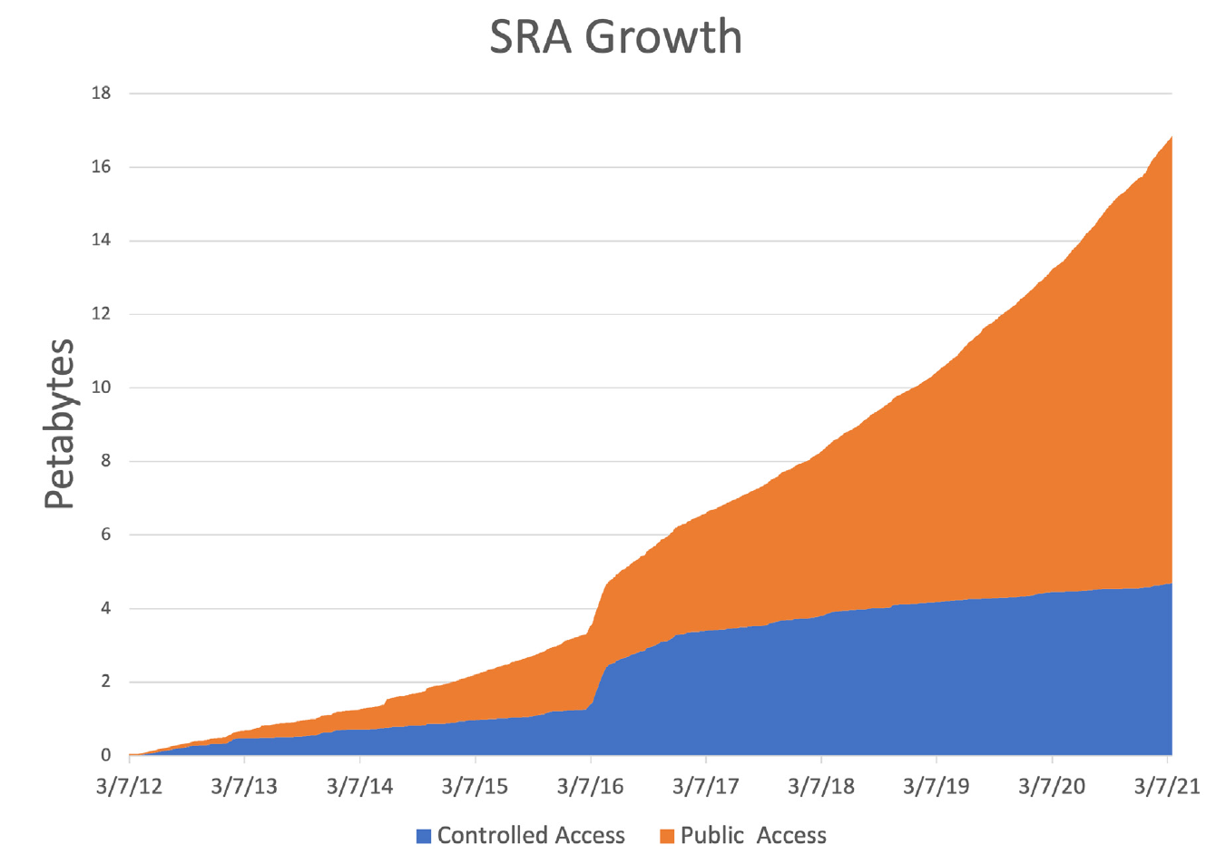
The amount of genome sequences available has grown explosively
Allows the study of every aspect of DNA’s structure and variation
We can compare genomes to infer how they change over time
Source: Katz et al. 2021, NAR
Notes:
And the prospects of the analysis of whole genomes, along with improved and less expensive sequencing technology means we’re in the middle of a sequencing boom. Here is a graph from the people at NCBI which host the sequence read archive, which is a common repository for researchers to submit their raw sequence data for a project. And you can see how its grown over the past decade. Since 2016, when it hosted a little under 4 petabytes of data, we’re up to almost 17pb in 2021, with projected growth of up to 33pb by this year.
So this means that anyone who has questions about the genomes in the archive, can go here and download the raw data and do their own analyses.

Slide 4
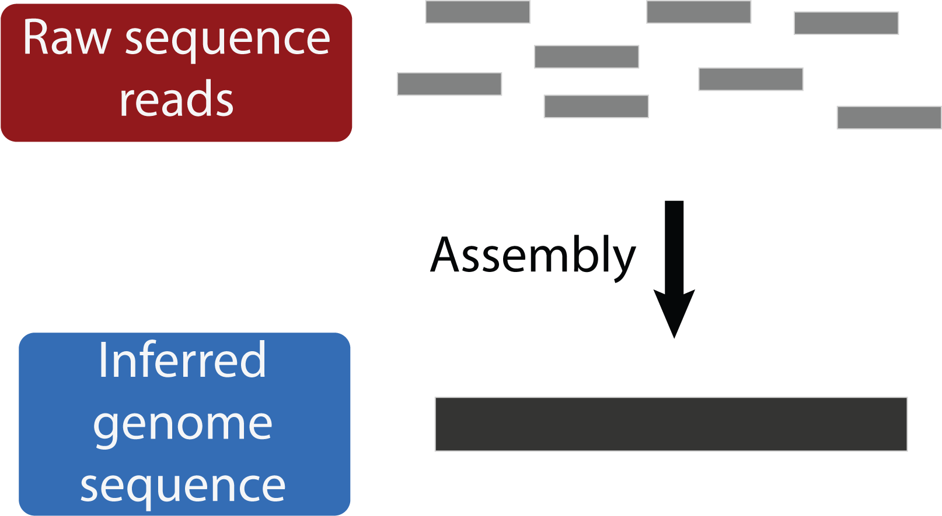
Genome assembly uses sequenced reads to infer the original genome sequence
Often the desired final product
Notes:
Well, what do we do with this data? One of the common and desired outcomes of a genome sequencing project is a whole genome assembly, which is the reconstruction of the short reads that were sequenced into a contiguous inference of the sequence of the original genome.

Slide 5
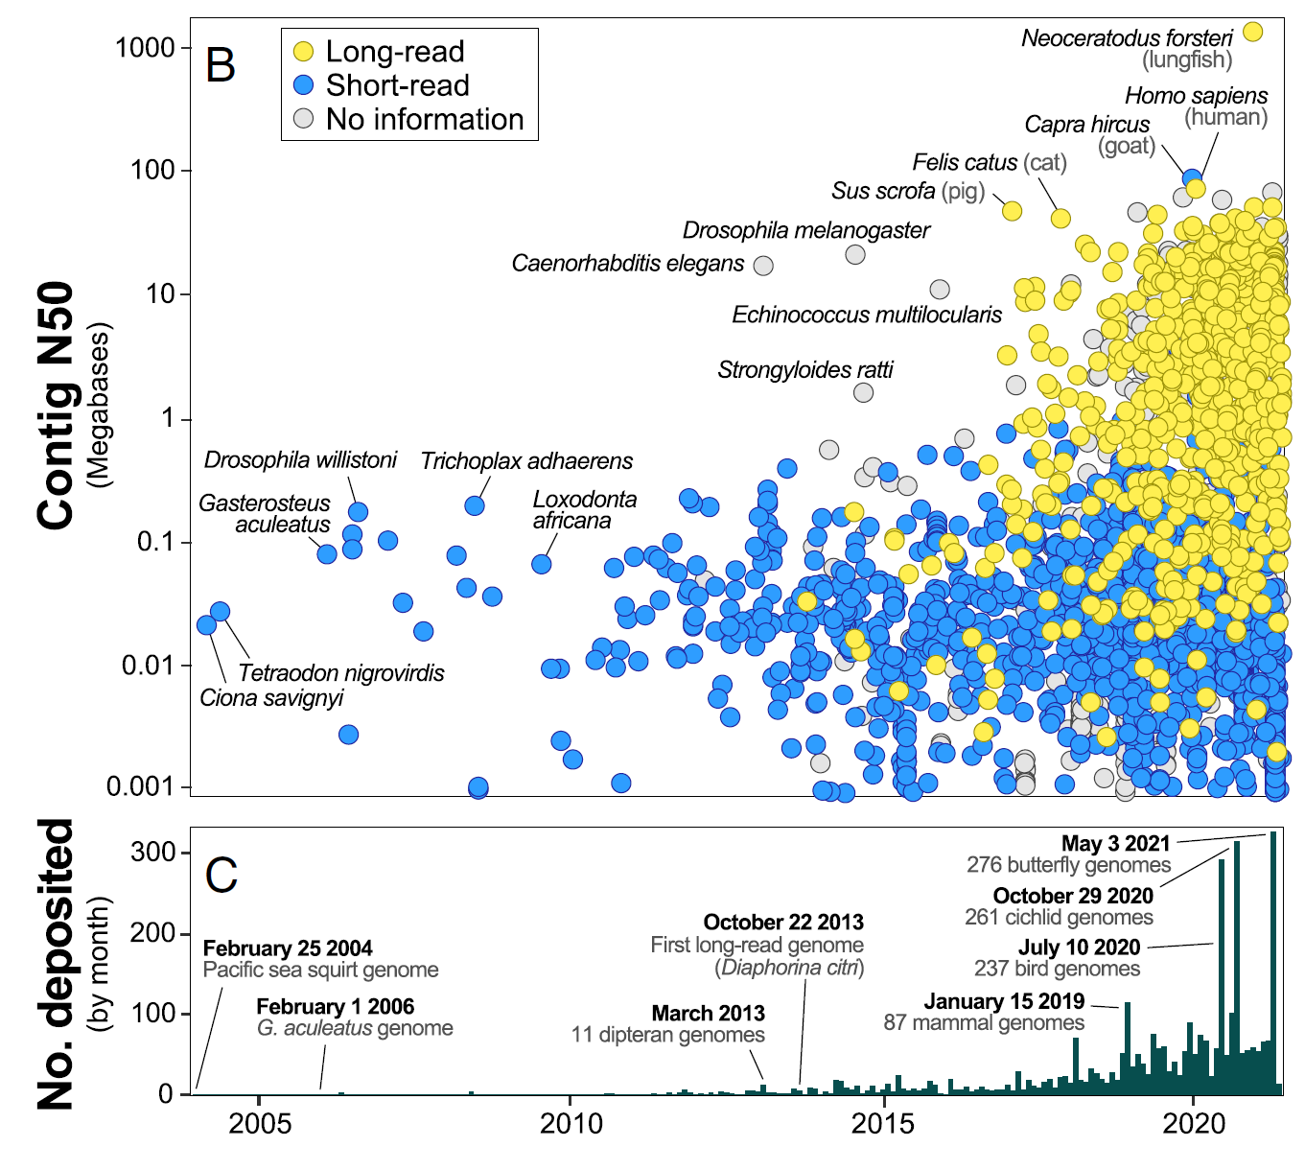
Genome assembly uses sequenced reads to infer the original genome sequence
Often the desired final product
Becoming easier to achieve
Source: Hotaling et al. 2021, PNAS
Notes:
This is becoming easier as well, as methods and technologies evolve. Specifically technologies that provider longer reads mean faster assembly algorithms can be used and longer assemblies can be produced. And you can see here how these long read assemblies in yellow have taken over those present in GenBank, which is NCBI’s repository for genome assemblies. And on the bottom you can see that the number of assembleis submitted per month is also increasing.

Slide 6
Genome assembly uses sequenced reads to infer the original genome sequence
Often the desired final product
Becoming easier to achieve
Still expensive and time-consuming to generate high quality assemblies
Source: Hotaling et al. 2021, PNAS
Notes:
While it is becoming easier to generate whole genome assemblies, it is still expensive and time-consuming to generate high quality assemblies, those that are contiguous at the chromosome level and well annotated.

Slide 7
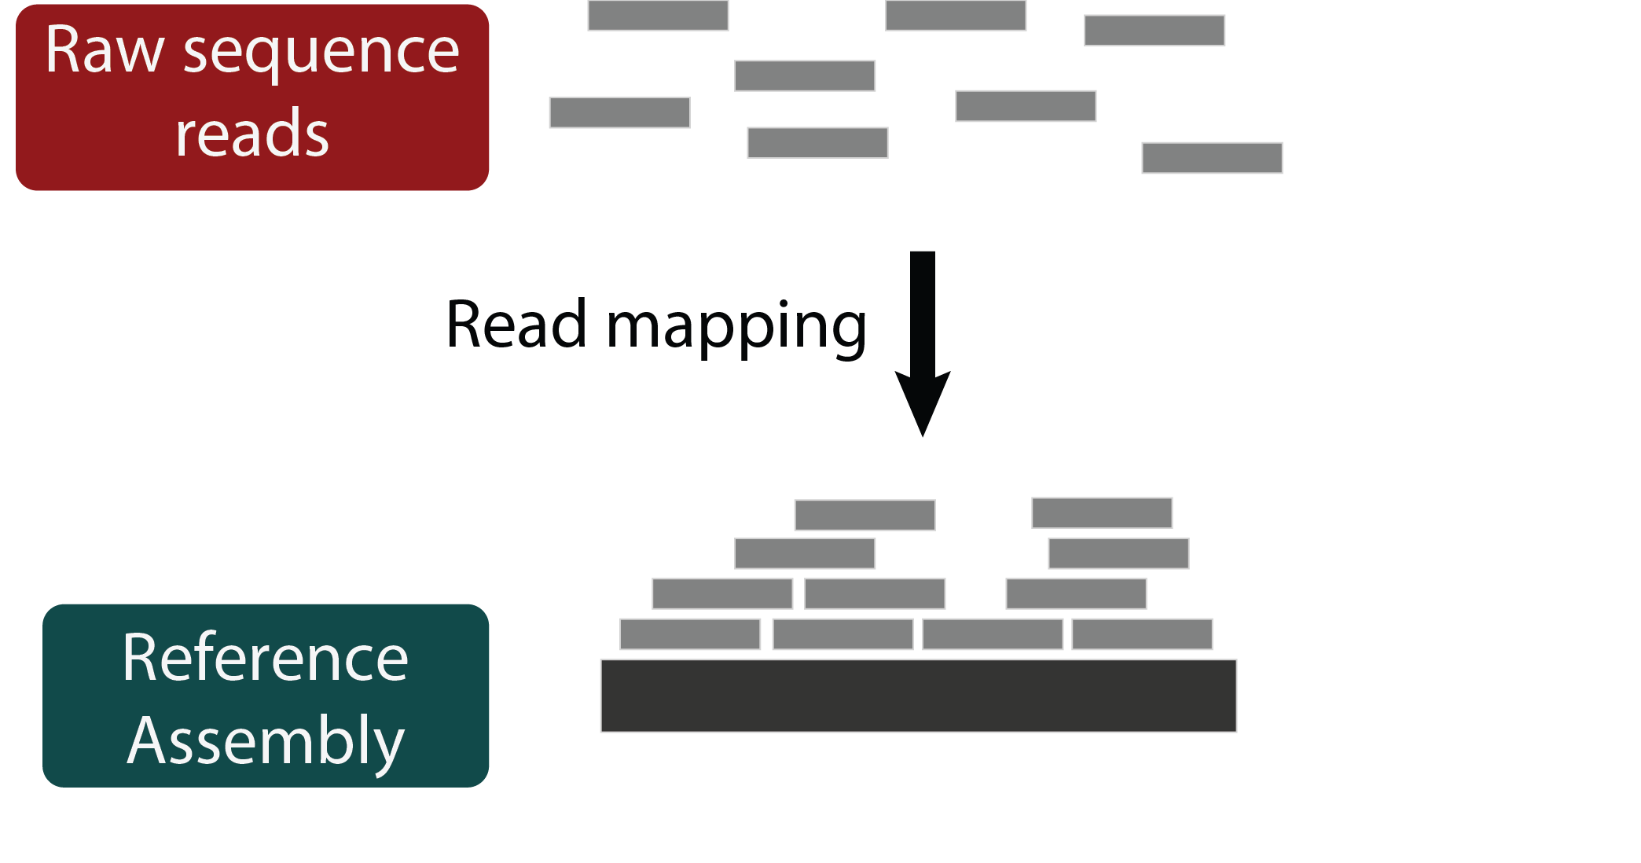
Read mapping is a fast alternative to genome assembly
Commonly done for both population and comparative genomics
Notes:
So a faster alternative to genome assembly may still be preferable in many situations, particularly in large re-sequencing studies or comparative genomics projects. And that alternative has historically been read mapping, which is when we use a previously assembled high quality genome from a closely related species as a reference and simply try to align the raw sequence reads to it.

Slide 8
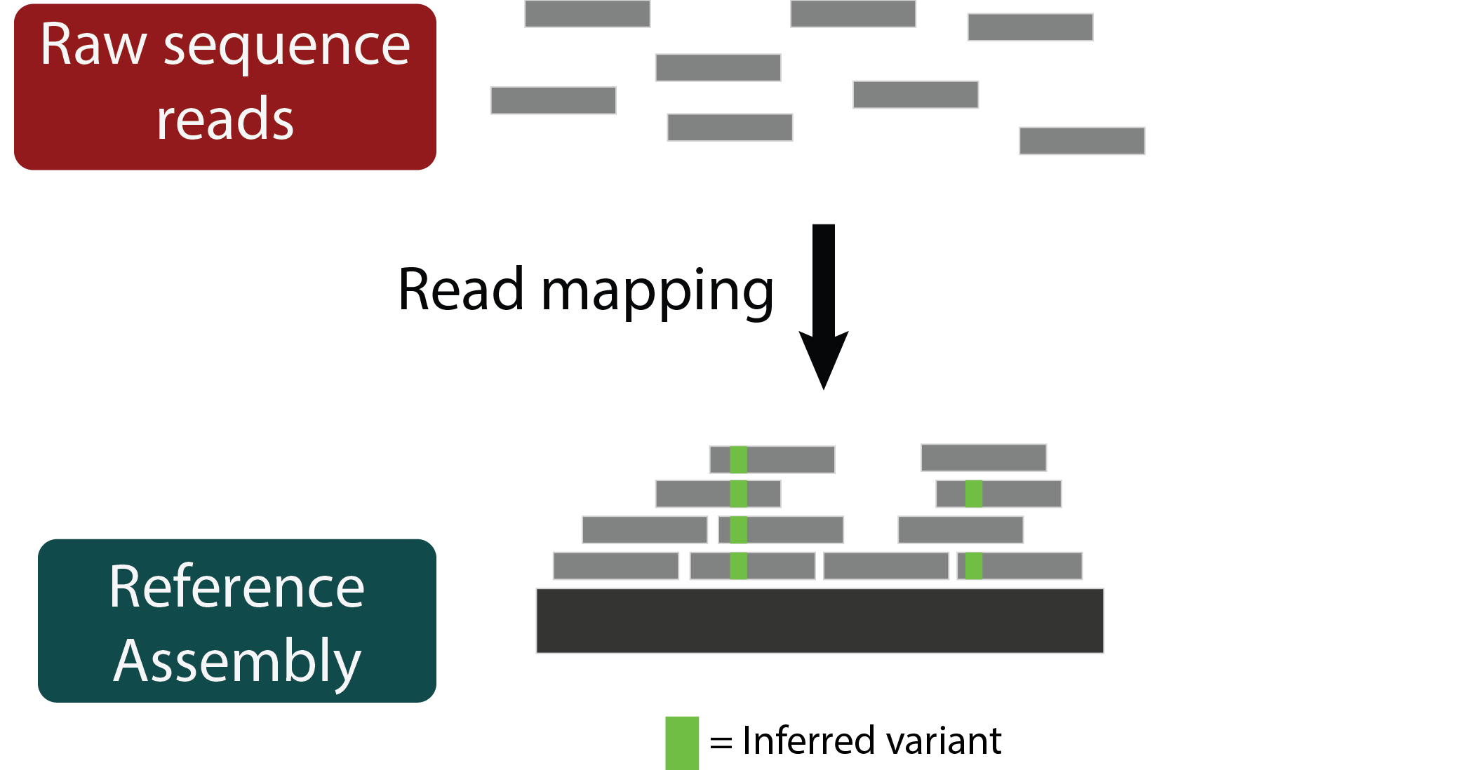
Read mapping is a fast alternative to genome assembly
Commonly done for both population and comparative genomics
Used for comparing short variation between genomes
Notes:
And we can use these alignments to identify where small variants, like single nucleotide changes or small insertions or deletions have occurred. And there’s a lot we can do with this information: we can estimate divergence or heterozygosity, we can infer substitution rates and phylogenetic relatedness, or lift over annotations from the reference genome to identify sites we think may have experienced positive selection.

Slide 9
Read mapping is a fast alternative to genome assembly
Commonly done for both population and comparative genomics
Used for comparing short variation between genomes
Cannot infer large structural variation
Notes:
So read mapping is an integral genomics tool, but it doesn’t let us do everything we could with a whole genome assembly. For instance, large structural variation cannot be inferred, and lifting over coordinate systems between a reference genome and a mapped sample can be tricky.

Slide 10
Read mapping is a fast alternative to genome assembly
Commonly done for both population and comparative genomics
How well does read mapping actually capture short variation in a sample with varying levels of divergence?
Used for comparing short variation between genomes
Cannot infer large structural variation
Notes:
So we know we can’t do those things, but what I was interested in asking is how well read mapping can capture what we think it does, the short variation like SNPs and indels, in the common comparative genomics framework where the samples exist at varying levels of divergence from the reference.

Slide 11
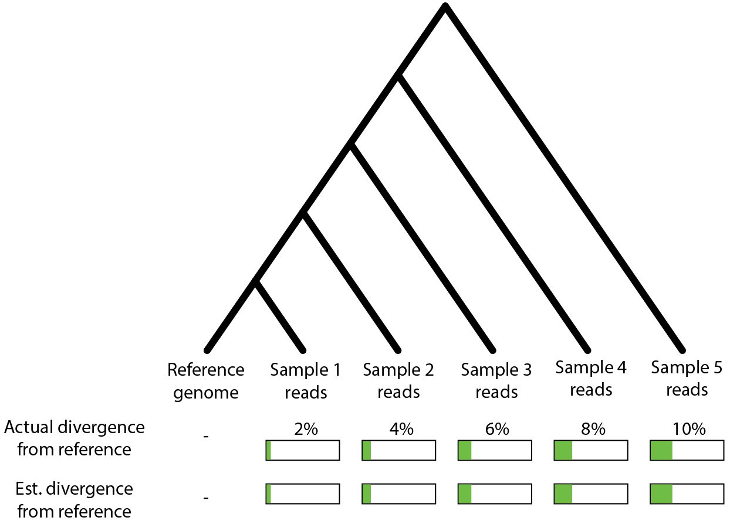
Does read mapping accurately capture variation among samples?
Notes:
So, to state my question explicitly, lets say we have a really good reference genome here.

Slide 12
Does read mapping accurately capture variation among samples?
Notes:
And we’ve sampled a bunch of other species and sequenced their genomes. Since we’ve spent all this time getting this one high quality reference, we decide to just map the reads from these samples to it.

Slide 13
Does read mapping accurately capture variation among samples?
Notes:
These samples exist at varying levels of divergence, which we probably don’t know ahead of time, but for this cartoon we do…

Slide 14
Does read mapping accurately capture variation among samples?
Notes:
Then, if read mapping is effective, when we map the reads and call variants to estimate divergence, we should see roughly the same estimates as their actual divergence.

Slide 15
Does read mapping accurately capture variation among samples?
?
?
?
?
?
Notes:
So my question is: Is this what actually happens?

Slide 16
Read mapping may struggle with reads that have lots of variation relative to the reference
Notes:
And to explain the reason we think this may not be the case I’ll return to this simple outline of the read mapping process

Slide 17
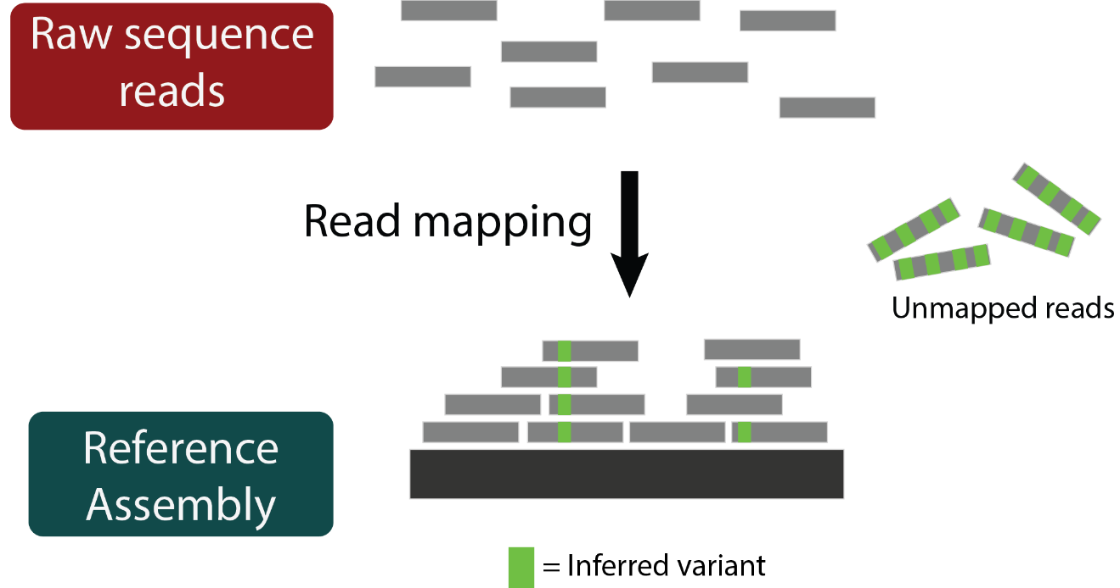
Read mapping may struggle with reads that have lots of variation relative to the reference
Notes:
Since read mapping is sequence alignment, its effectiveness is based on sequence similarity. That means reads that contain lots of actual variants may be unmapped simply because of those variants. This is called reference bias and means that those highly diverged regions may not be reflected in the final set of variants called, so we may expect lower estimates of divergence.

Slide 18
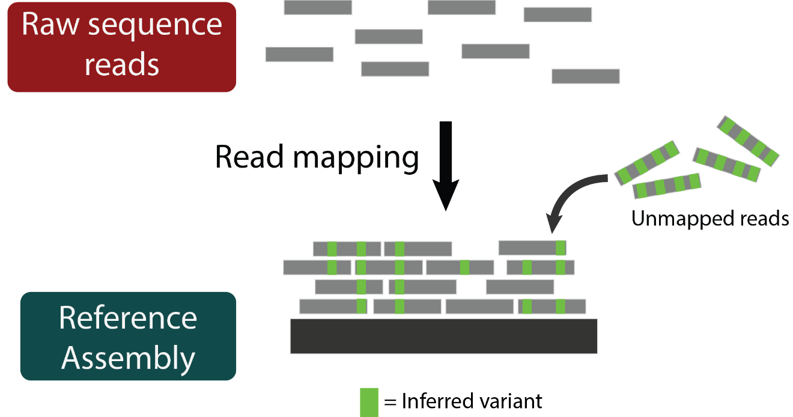
Read mapping may struggle with reads that have lots of variation relative to the reference
Notes:
Consequently if we could map those reads, we would incorporate that variation into our estimates and they would be more accurate.

Slide 19
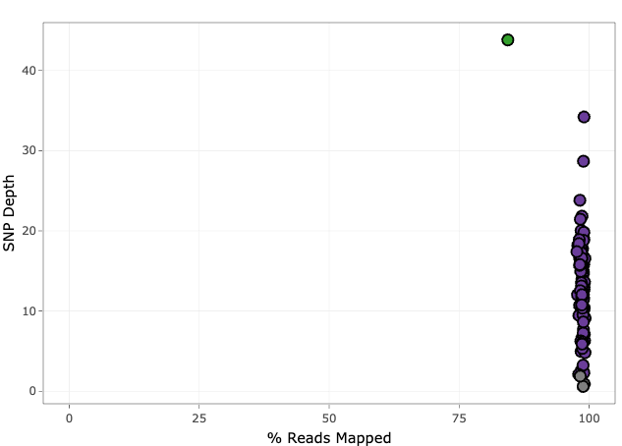
Reference bias may be caused by unmapped reads in diverged samples
Source: Tim Sackton, personal comm.
Notes:
There’s some evidence to suggest this may be the case. In some of our projects around the lab specifically we’ve seen that diverged samples have lower percentages of reads mapped correctly. So here I’m showing on the x-axis the percent of reads mapped to the reference for a bunch of samples.

Slide 20
Reference bias may be caused by unmapped reads in diverged samples
Athene cunicularia (burrowing owl); reference genome for mapping
Source: Tim Sackton, personal comm.
Notes:
In this case the purple points are samples of the burrowing owl, one of which is also the reference genome used for read mapping

Slide 21
Reference bias may be caused by unmapped reads in diverged samples
Glaucidium brasilianum (ferruginous pygmy-owl)
Athene cunicularia (burrowing owl); reference genome for mapping
Source: Tim Sackton, personal comm.
Notes:
This one green point belongs to a different species but was still mapped to the burrowing owl genome, and you can see a shift on the x-axis. While all the burrowing owl samples have almost 100% of reads mapped, this sample has about 80%.

Slide 22
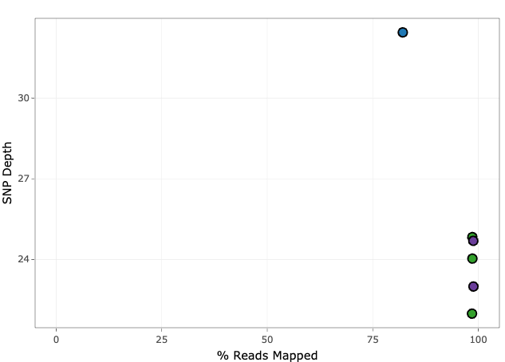
Reference bias may be caused by unmapped reads in diverged samples
Glaucidium brasilianum (ferruginous pygmy-owl)
Cochlearius cochlearius (boat-billed heron)
Athene cunicularia (burrowing owl); reference genome for mapping
Egretta garzetta (little egret); reference genome for mapping
Source: Tim Sackton, personal comm.
Notes:
And this is pervasive across many re-sampling projects.

Slide 23
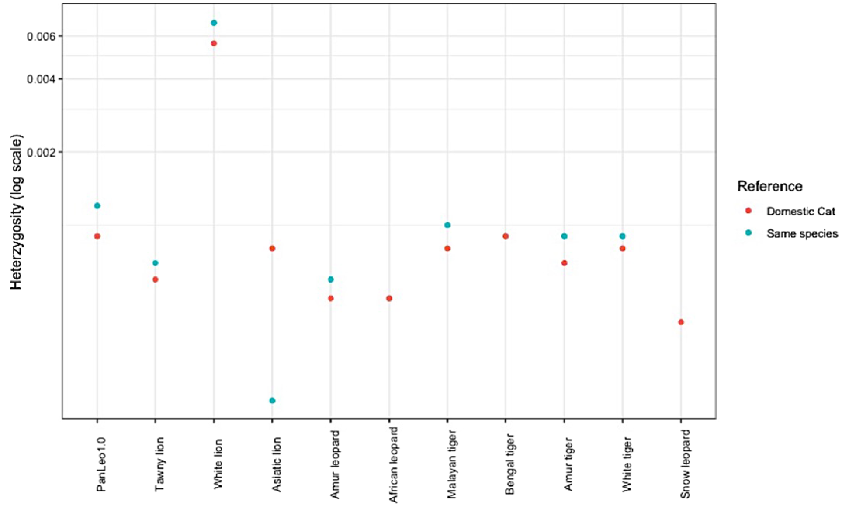
Reference bias can impact measures of sequence divergence
Mapping to a more closely related genome results in increased estimates of heterozygosity in felids
Source: Armstrong et al. 2020, BMC Bio
Notes:
And these unmapped reads can have affects on downstream analyses. I’m not aware of many explicit examples of this in the literature, but this one is really nice. In this paper, Armstrong et al. show that when different species of felids are mapped to a genome from their own species, estimates of heterozygosity go up compared to when they are all mapped to the domestic cat genome.

Slide 24

Reference bias can impact measures of sequence divergence
Source: Armstrong et al. 2020, BMC Bio
Notes:
This may be a case of the variation in some reads preventing them from mapping to a diverged reference, but being able to be mapped in a closer reference and those variants being captured in these estimates of heterozygosity.

Slide 25
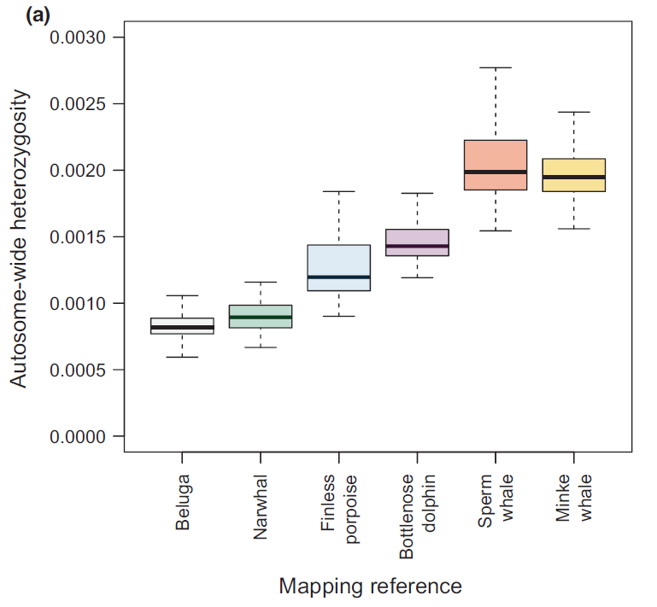
Reference bias can impact measures of sequence divergence
The opposite is observed in whales – heterozygosity increases with increasing divergence from the reference
Source: Prasad et al. 2021, MER
Notes:
Strangely enough, the only other explicit test for reference bias I’ve found show’s an opposite pattern. Here, Prasad et al. map the genome of the beluga whale to reference genomes from various other species, here listed on the x-axis in increasing levels of divergence from the beluga. They actually observe increased heterozygosity with increased divergence, unlike what Armstrong et al. saw in the cats. They attribute this to possible mis-alignments, and various other methods they tried suggest different results.

Slide 26
Reference bias can impact measures of sequence divergence
The opposite is observed in whales – heterozygosity increases with increasing divergence from the reference
We sought to quantify reference bias by using simulated genomes and reads
Source: Prasad et al. 2021, MER
Notes:
SO clearly reference bias is a problem, though not often discussed in the literature, and we wanted to rigorously quantify it by using simulations.

Slide 27
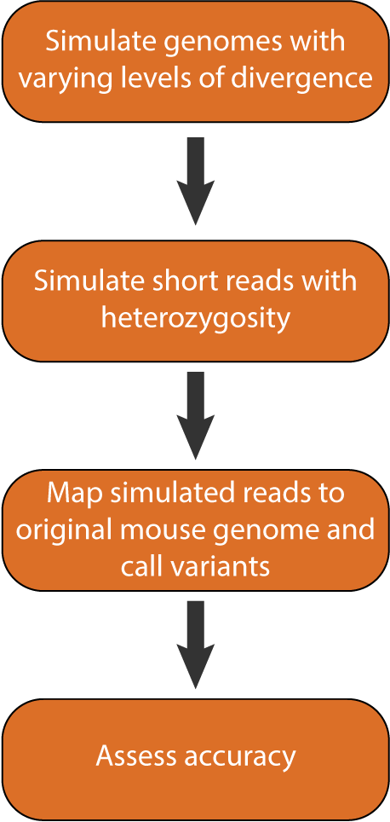
Reference bias simulations
0.02, 0.04, 0.06, 0.08, 0.10
30X coverage,
0.005 heterozygosity
BWA, GATK
Notes:
So I’ll briefly outline our simulation workflow. First, we needed to simulate diverged genomes from which we’d simulate reads to map.

Slide 28
Reference bias simulations
Based off mouse genome
0.02, 0.04, 0.06, 0.08, 0.10
30X coverage,
0.005 heterozygosity
BWA, GATK
Notes:
And we did this based off of the mouse reference genome. We could’ve chosen any genome to do this, but I’m familiar with the mouse genome and it is chromosome level and well annotated, so this seemed good.
And we inserted variation at between 2 and 10% of sites.

Slide 29
Reference bias simulations
Based off mouse genome
0.02, 0.04, 0.06, 0.08, 0.10
30X coverage,
0.005 heterozygosity
BWA, GATK
Notes:
Next we took each of these genomes and simulated short reads with them. And for now we’ve only done 30X coverage and 0.5% heterozygosity.

Slide 30
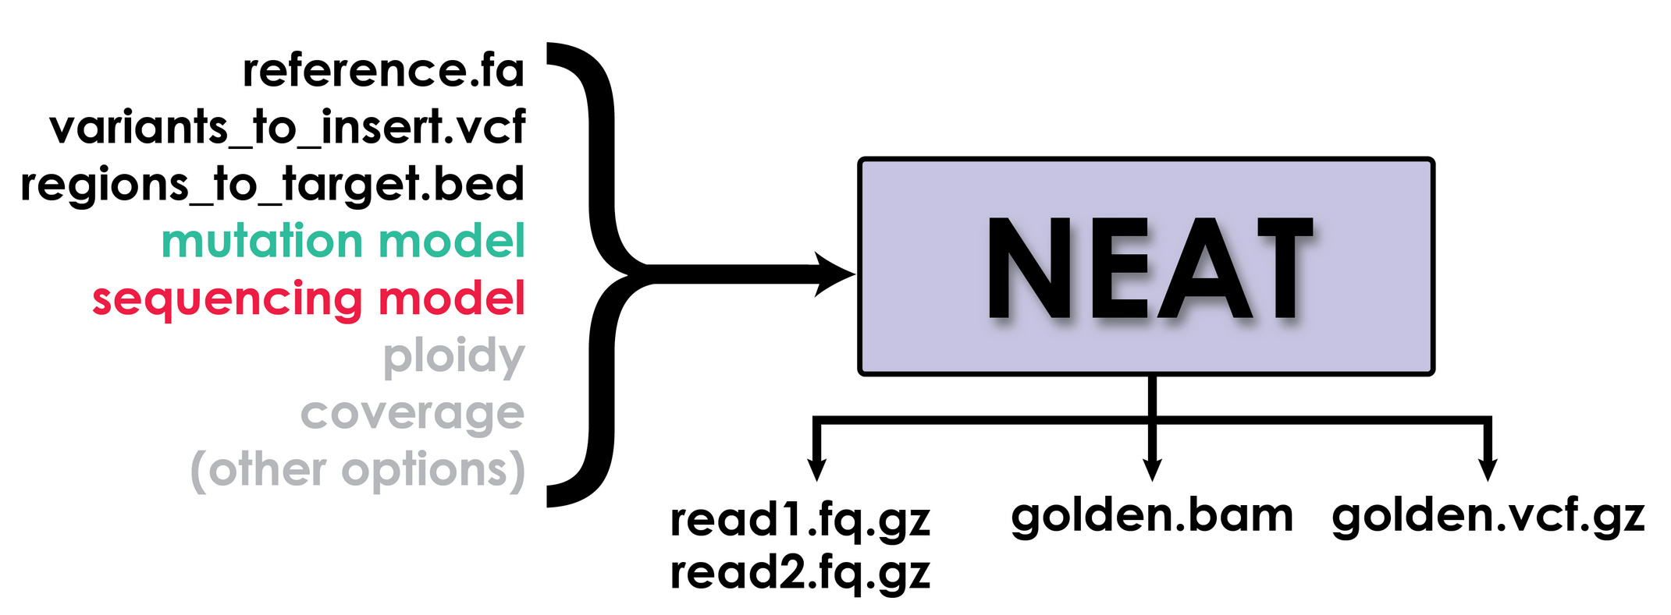
Reference bias simulations
Based off mouse genome
0.02, 0.04, 0.06, 0.08, 0.10
30X coverage,
0.005 heterozygosity
BWA, GATK
NEAT: Stephens et al. 2016, PLoS One; https://github.com/ncsa/NEAT
Notes:
For both of these steps we used this read simulator called NEAT. For step one we just took the variants it inserted into the reads and put them into the mouse genome, and for the second step we actually used the reads.
The main reason we wanted to use NEAT for everything is that they provide as output from each run a golden BAM file and a golden VCF file containing the true locations of where reads should map and where variants were inserted. So this gives us and easy comparison for each level of divergence.

Slide 31
Reference bias simulations
Based off mouse genome
0.02, 0.04, 0.06, 0.08, 0.10
30X coverage,
0.005 heterozygosity
BWA, GATK
NEAT: Stephens et al. 2016, PLoS One; https://github.com/ncsa/NEAT
Notes:
Then we mapped the simulated reads from each diverged genome back to the original mouse genome and called variants in a pretty typical way with BWA and GATK.

Slide 32
Reference bias simulations
Based off mouse genome
0.02, 0.04, 0.06, 0.08, 0.10
30X coverage,
0.005 heterozygosity
BWA, GATK
% reads correctly mapped
# variants correctly called
NEAT: Stephens et al. 2016, PLoS One; https://github.com/ncsa/NEAT
Notes:
And for each of these we’ll assess accuracy of both the mapped reads and the called variants

Slide 33
Reference bias simulations
Based off mouse genome
0.02, 0.04, 0.06, 0.08, 0.10
30X coverage,
0.005 heterozygosity
BWA, GATK
?
?
?
?
?
% reads correctly mapped
# variants correctly called
NEAT: Stephens et al. 2016, PLoS One; https://github.com/ncsa/NEAT
Notes:
And this essentially sets us up with this situation except we know the actual level of divergence to compare to. So we’ll be able to fill in these question marks and quantify how divergence effects reference bias

Slide 34
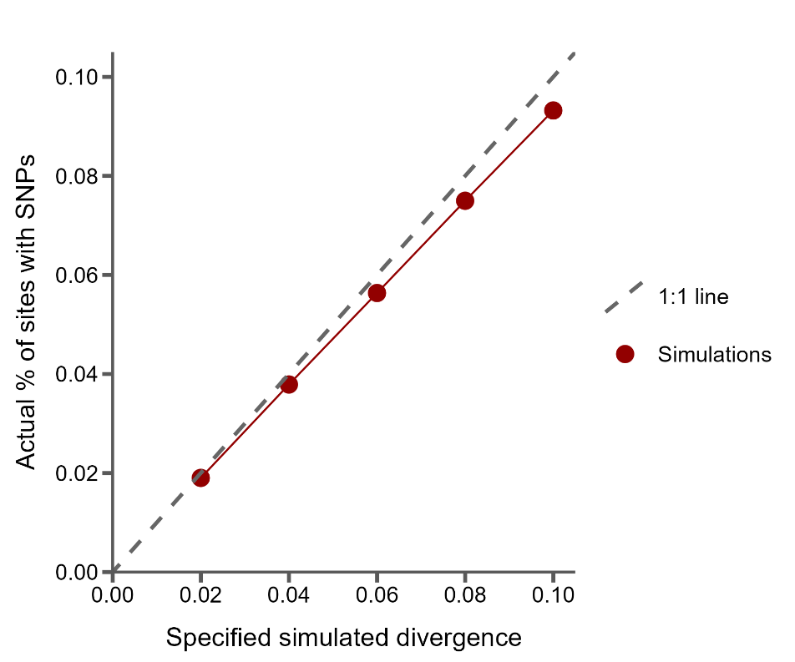
Sanity check: the % of SNPs simulated tracks specified divergence
Notes:
So, what did we find…
First I want to present just a sanity check from our simulations. Here on the x-axis I’m showing the specified divergence level for each simulation, and on the y-axis the actual percentage of sites with SNPs inserted in the golden VCF file.
The dashed grey line is the 1 to 1 line, which is where we hope our simulations fall. Each dot represents one simulated genome. And you can see the program is doing pretty well.

Slide 35
Sanity check: the % of SNPs simulated tracks specified divergence
However, with increasing divergence, fewer SNPs than expected are simulated
Possibly due to double hits
Notes:
Though as divergence increases we are slightly under-simulating variants. We think this is probably due to the simulator double-hitting sites more often as divergence increases. But I just wanted to show this because later on when I compare to expected levels of divergence, I’ll keep labeling as what we simulated, but the underlying numbers are actually slightly lower in some cases.

Slide 36
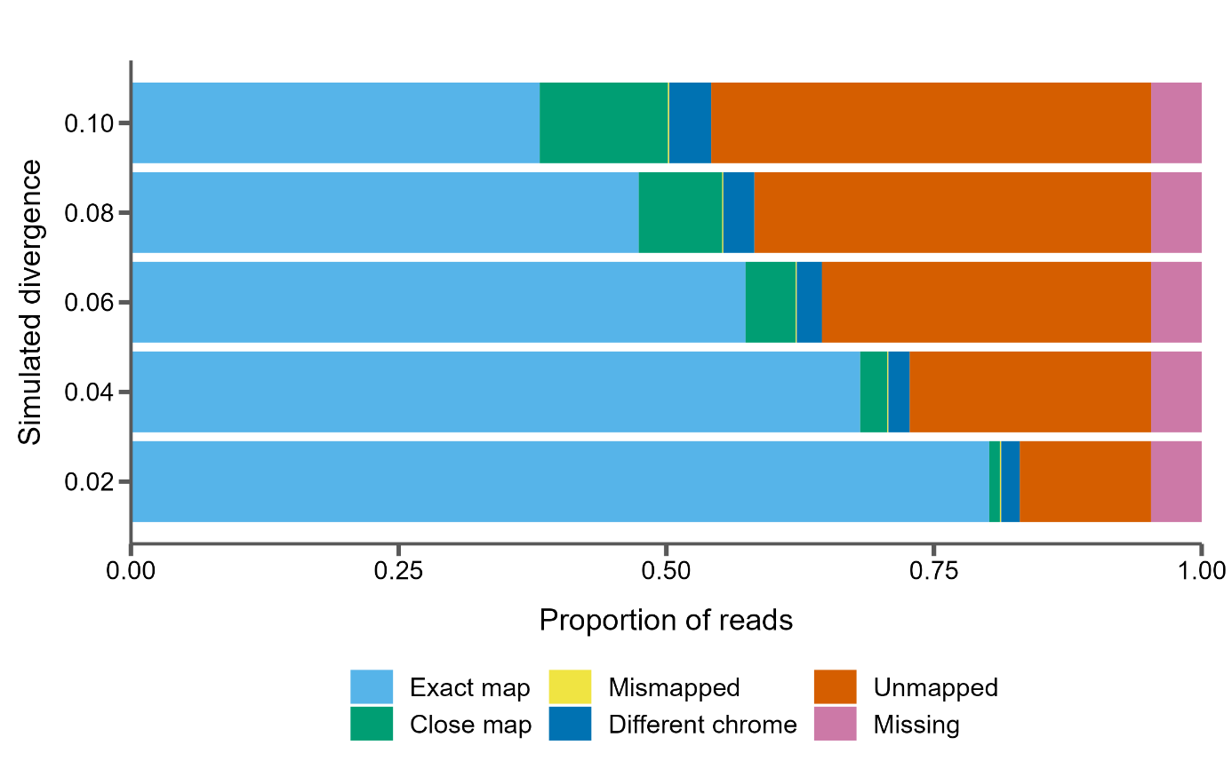
Read mapping accuracy with increasing divergence
Notes:
Next I want to show how well the reads are mapped back to the original genome for each level of divergence. And I’ll do this by showing proportional bar plots where on the x-axis we have the proportion of reads broken up into different categories based on these colors. I think most of these are self-explanatory, except for “Close map”, which means that read mapped within 1 read length (which is 150bp) of the true mapping position.
And on the y-axis we have the different simulations.
Chrome?

Slide 37
80% of reads mapped correctly at 2% divergence
12% of reads unmapped at 2% divergence
Notes:
I’ll start with our reads simulated with 2% sequence divergence. Here we see that 80% of reads map exactly where they should, these are the ones in light blue in the bar. I think this is good, but it is still kind of striking that nearly 12% of reads are unmapped, that’s this chunk in red.
Chrome?

Slide 38
Only 38% of reads map correctly at 10% divergence
12% of reads unmapped at 2% divergence
40% of reads unmapped at 10% divergence!
Notes:
And as we expected, the proportion of unmapped reads increases with divergence from the reference. But I was surprised by the extent of this increase: at 10% divergence only 38% of reads map correctly and 41% are unmapped! We also see an increase in the number of reads that map close to their expected position, but not exactly correctly.
Get examples?
Chrome?

Slide 39
The number of unmapped reads increases linearly with divergence
12% of reads unmapped at 2% divergence
40% of reads unmapped at 10% divergence!
Notes:
We also noticed that the number of unmapped reads increases almost linearly, which I’ve approximated here just by drawing a line over the red bars. This is interesting and suggests that we could possibly model this and estimate sequence divergence between genomes based on the number of unmapped reads between them. Of course, real data is a lot messier than this so who knows if that will hold true.
Chrome?

Slide 40
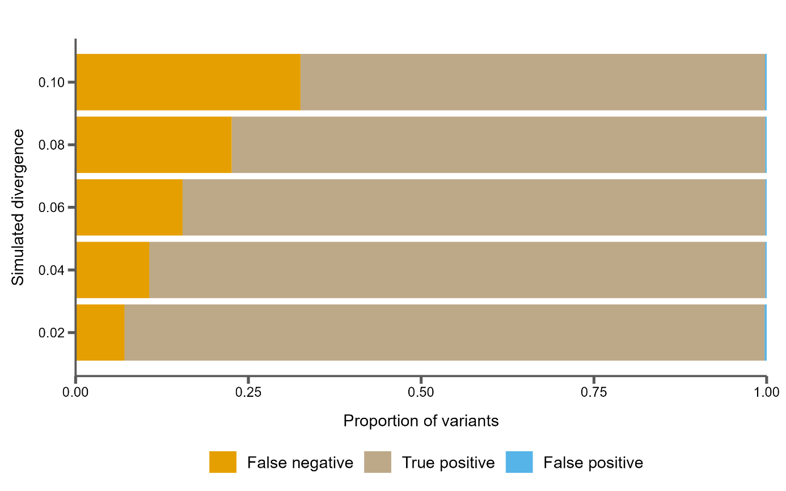
Variant calling accuracy with increasing divergence
Notes:
And we can do something similar for the called variants. Here I’ll show you a similar proportional bar plot, but this time the x-axis has proportion of SNPs called in various categories compared to where they were actually simulated. For example, true positive means we simulated a variant there, and we’ve correctly called it as homozygous alternate compared to the reference genome.
Chrome?

Slide 41
Variants are increasingly missed as divergence goes up
False negatives rise from 7% to 33% of all variants called
Notes:
And as expected with the increasing number of unmapped reads, we see an increasing number of false positive variant calls. That is, we simulated a variant at this position, but after read mapping and variant calling we failed to identify it. And these range from 7% of all variants at 2% sequence divergence to missing one third of all variants at 10% divergence.
Chrome?

Slide 42
Variants are increasingly missed as divergence goes up
False negatives rise from 7% to 33% of all variants called
The proportion of false positives does not increase
Notes:
Interestingly, the proportion of false positive variant calls does not increase at all. In fact, there are barely any false positive calls. This is good and I think also expected especially in such a clean simulation: the variant caller isn’t going to call something that doesn’t exist in any of the reads, and unmapped reads shouldn’t somehow introduce evidence for variants that aren’t there.
Chrome?

Slide 43
Iterative mapping to mitigate the effects of reference bias
However, with increasing divergence, fewer SNPs than expected are simulated
Notes:
Keep simulated divergence 0?
Chrome?

Slide 44
Read mapping may struggle with reads that have lots of variation relative to the reference
Notes:
And if we could map those reads, we would incorporate that variation into our estimates.

Slide 45
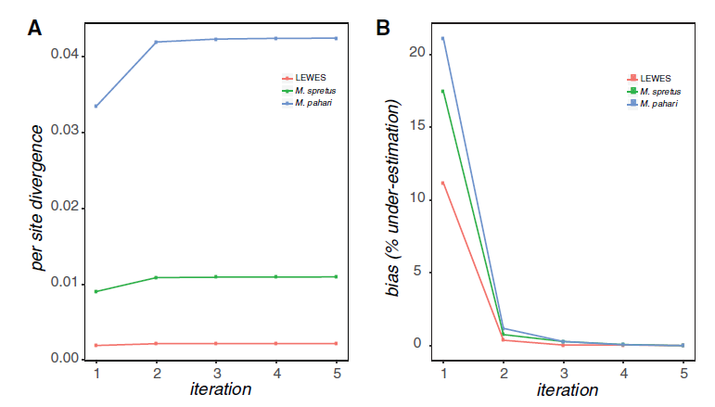
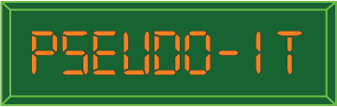
Iterative mapping to mitigate the effects of reference bias
Source: Sarver et al. 2017, GBE
Notes:
Keep simulated divergence 0?
Chrome?

Slide 46
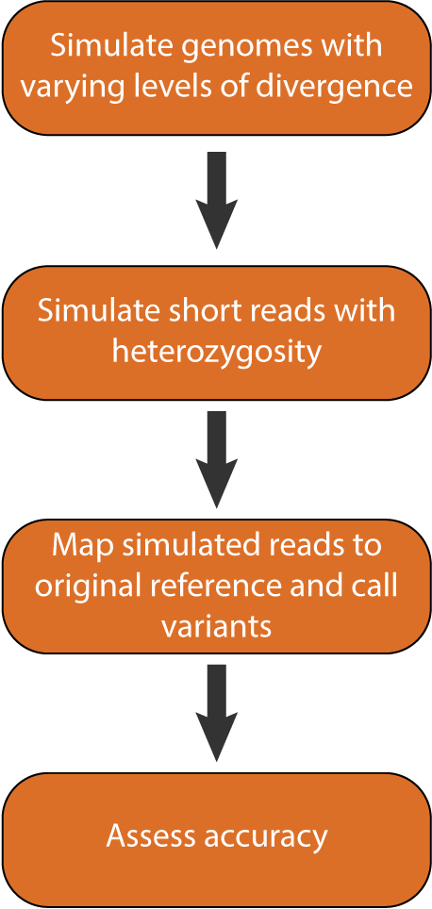
Read simulations
0.02, 0.04, 0.06, 0.08, 0.10
30X coverage,
0.005 heterozygosity
BWA, GATK

Slide 47
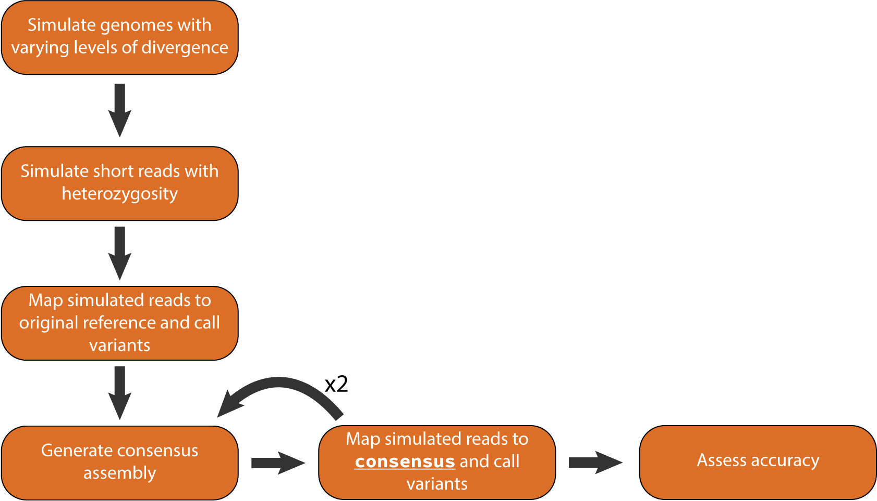
Read simulations with iterative mapping
0.02, 0.04, 0.06, 0.08, 0.10
30X coverage,
0.005 heterozygosity
BWA, GATK
bcftools
BWA, GATK, minimap2

Slide 48
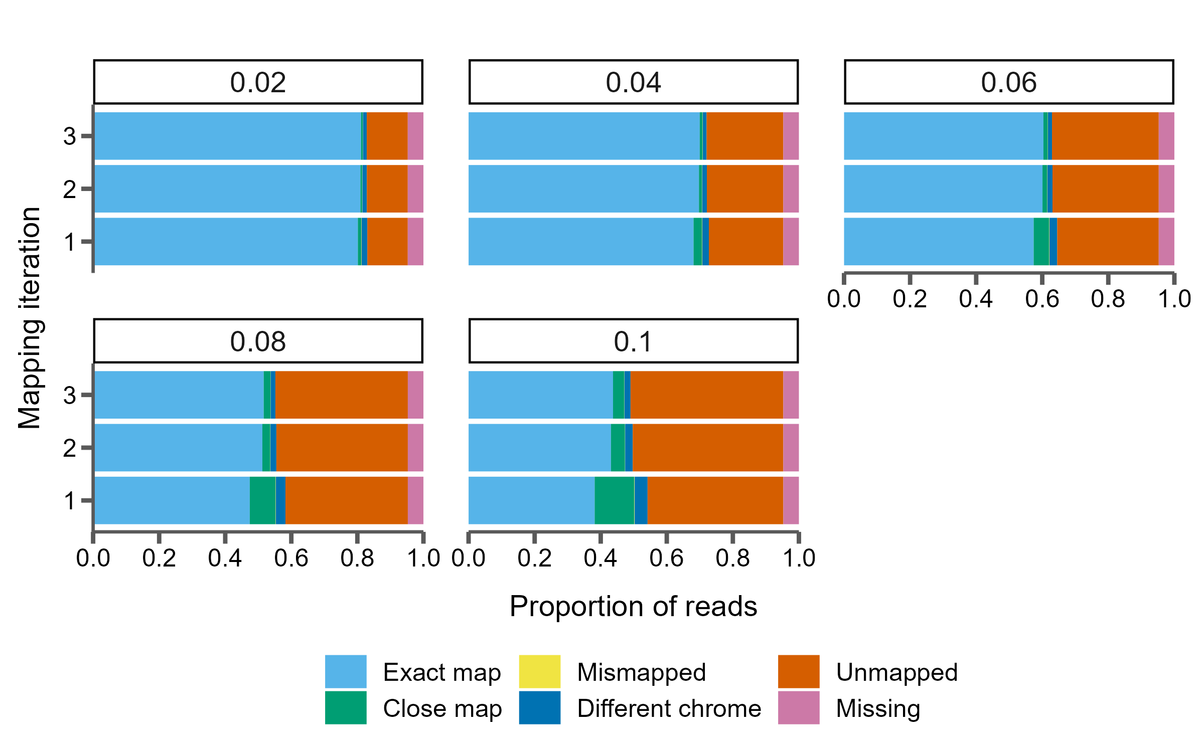
One extra iteration of mapping increases correctly mapped reads at high levels of divergence
However, with increasing divergence, fewer SNPs than expected are simulated
Notes:
Chrome?

Slide 49
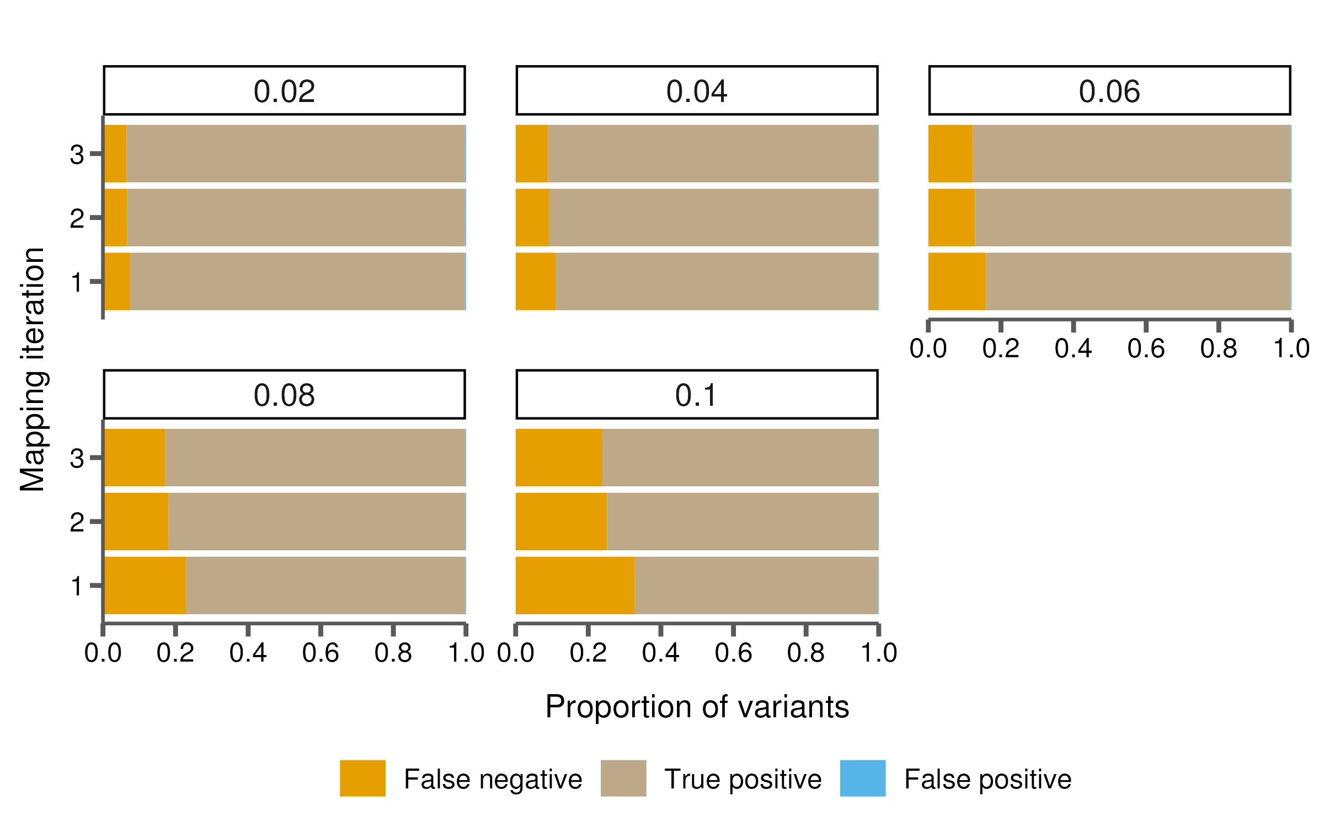
And also results in fewer missed variants
However, with increasing divergence, fewer SNPs than expected are simulated
Notes:
Chrome?

Slide 50
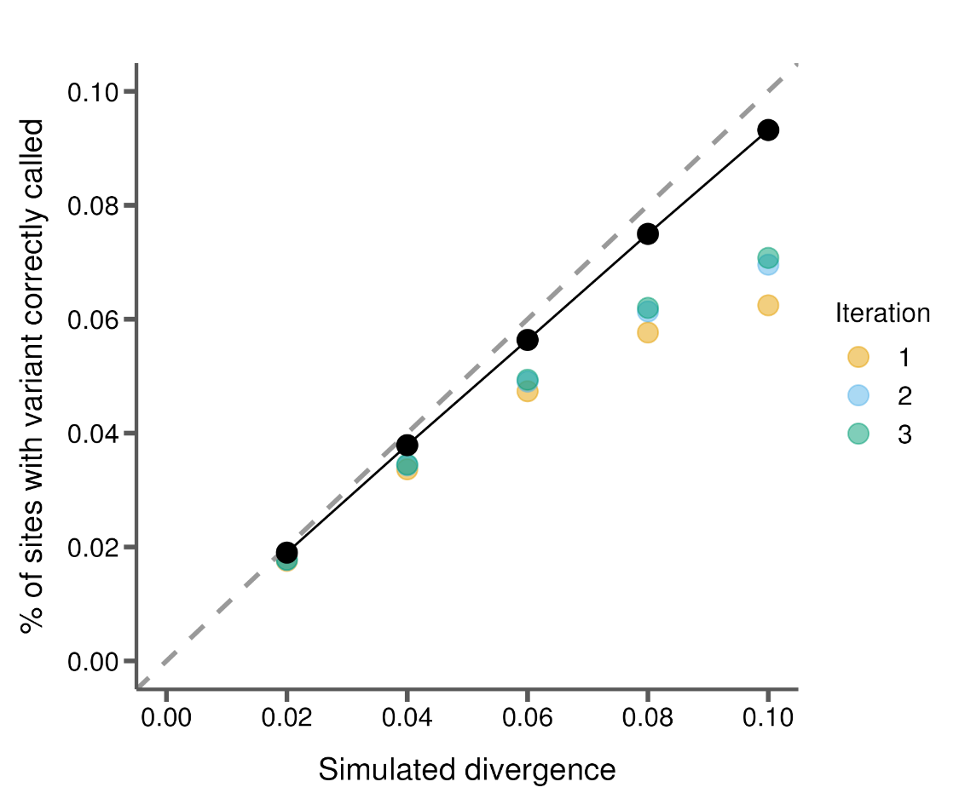
One iteration of mapping makes up for some of the missed variation, but not all
However, with increasing divergence, fewer SNPs than expected are simulated
Notes:
Divergence est. correctly using only variants known to be called accurately? no

Slide 51
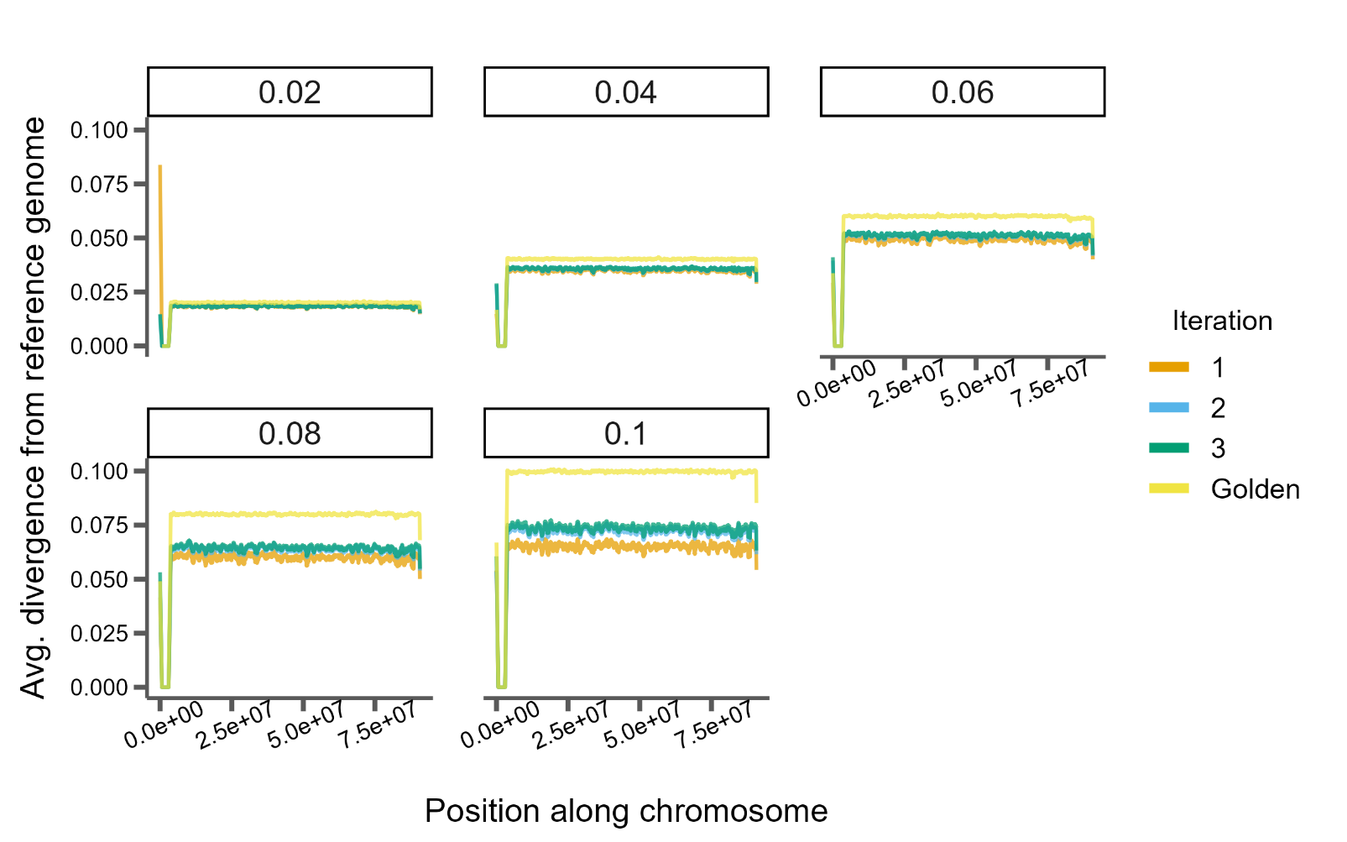
And also results in fewer missed variants
However, with increasing divergence, fewer SNPs than expected are simulated
Notes:
Correctly est. divergence across genome? no

Slide 52
We show that an extra iteration of mapping might help at higher levels of divergence

Slide 53
Next
Long reads and mappers
Where are the false negatives (genes, repeats, etc.)?
Heterozygosity? Coverage? How do these things affect everything?

Slide 54




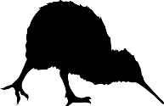
AACATCGGAGCCA
AACATCGGAGCCA
AACATCGGAGCCA
ATCATCGAAGGTA
GACGTCATAGCGC
= Flightless
Notes:
But another powerful method for relating genotype to phenotype is comparative phylogenomics, where we compare genomes from many species to identify where they differ from one another and correlate those differences with variation we observe in their phenotypes, such as loss of flight in certain birds.

Slide 55
AACATCGGAGCCA
AACATCGGAGCCA
AACATCGGAGCCA
ATCATCGAAGGTA
Accelerated
GACGTCATAGCGC
= Flightless
Accelerated
Notes:
And one way to do this is to look for specific parts of the genome that have a higher rate of substitutions in some species than in others. For example, in this cartoon the flightless ostrich and kiwi have accelerated rates of substitution for this element of the genome compared to these flying birds. This let’s us hone in on genomic elements that may play a role in this trait.
A lot of software does this in the context of coding sequences, where they compare synonymous to non-synonymous substitution rates to test for accelerated evolution. But this isn’t applicable to study regulatory regions which lack this natural comparison.

Slide 56
AACATCGGAGCCA
AACATCGGAGCCA
PhyloAcc v1
AACATCGGAGCCA
Hu et al. 2019
ATCATCGAAGGTA
Accelerated
GACGTCATAGCGC
= Flightless
Accelerated
Notes:
So a few years ago, the first version of our program, PhyloAcc, tried to address this in a Bayesian framework by using genome-wide estimates of neutral substitution rates as a baseline comparison for rates in non-coding regions. It then tests several models against each other to determine which elements have accelerated rates on which lineages.

Slide 57

PhyloAcc v1
Hu et al. 2019
283,369 non-coding loci
62 mammal species
2,106 loci accelerated in marine mammals
Hu et al. 2019
Notes:
And using this framework, an analysis of non-coding sequences found 2,106 elements accelerated in marine mammals

Slide 58
284,001 non-coding loci
42 bird species
806 loci accelerated in ratites
Sackton et al. 2019
Hu et al. 2019
PhyloAcc v1
Hu et al. 2019
283,369 non-coding loci
62 mammal species
2,106 loci accelerated in marine mammals
Hu et al. 2019
Notes:
And 806 elements accelerated specifically in flightless birds, reflecting that regulatory evolution may play a role in the convergence of traits associated with these lifestyles.

Slide 59
AACATCGGAGCCA
AACATCGGAGCCA
PhyloAcc v1
AACATCGGAGCCA
Hu et al. 2019
ATCATCGAAGGTA
Accelerated
GACGTCATAGCGC
= Flightless
Accelerated
Notes:
So the first version of PhyloAcc shows that we can expand our analysis of sequence evolution beyond coding regions, opening up a new window into regulatory elements in a phylogenomic workflow.
However, this method uses the same input species tree for every locus it tests.

Slide 60
AACATCGGAGCCA
AACATCGGAGCCA
PhyloAcc v1
Phylogenetic discordance poses a problem for inferring rates of molecular evolution
AACATCGGAGCCA
Hu et al. 2019
ATCATCGAAGGTA
Accelerated
GACGTCATAGCGC
= Flightless
Accelerated
Notes:
This can be a problem if the histories of the underlying loci differ from that of the species tree. This can cause problems for any inference of molecular evolution, so I want to briefly explain what I mean by phylogenetic discordance.

Slide 61
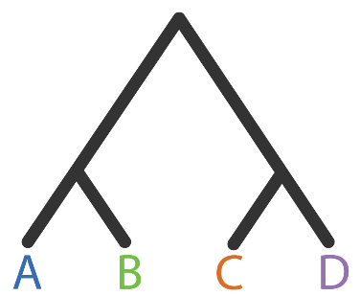
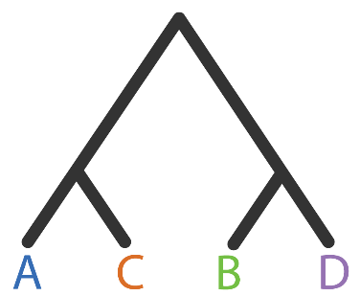
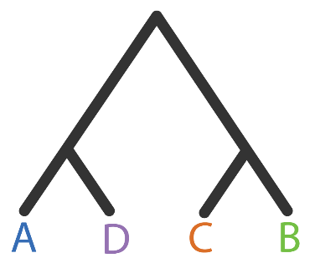
Phylogenies from different loci can disagree with each other
Gene tree 1
Gene tree 2
Gene tree 3
Notes:
So, in its most basic definition, phylogenetic discordance simply means that, for the same set of species, phylogenies inferred from different parts of the genome may disagree with each other. In this quartet example, we have three gene trees with discordant topologies. In the first tree A is sister to B, while in the second A is sister to C, and in the third A is sister to D.

Slide 62
Phylogenies from different loci can disagree with an inferred species tree
Concordant
Discordant 1
Discordant 2
Gene tree 1
Gene tree 2
Gene tree 3
Species tree
Notes:
Now, when we combine the information from all of our genes to infer a single species tree, we inevitably see discordance between that tree and many of the underlying gene trees. For instance, if we used some method to infer a species tree here and decide that this first tree’s topology matches species tree, the other two are then discordant with the species tree. So gene trees can be discordant among themselves and with the inferred species tree.

Slide 63
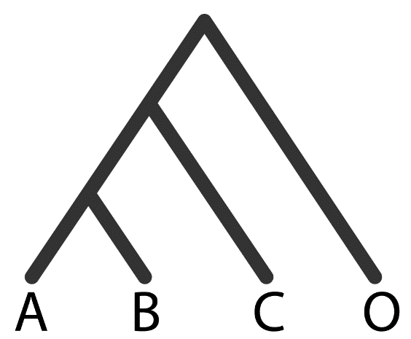

Mapping traits or variation onto a species tree from discordant loci can cause incorrect inferences
Species tree
Gene tree
Adapted from Mendes & Hahn 2016
Notes:
When this happens, mapping traits, including DNA sequences, onto discordant phylogenies can affect inferences about them.
For example, let’s say we have our species tree, and the gene tree from one locus for these species. These topologies disagree, with A and B being sister in the species tree and B and C sister in the gene tree.

Slide 64
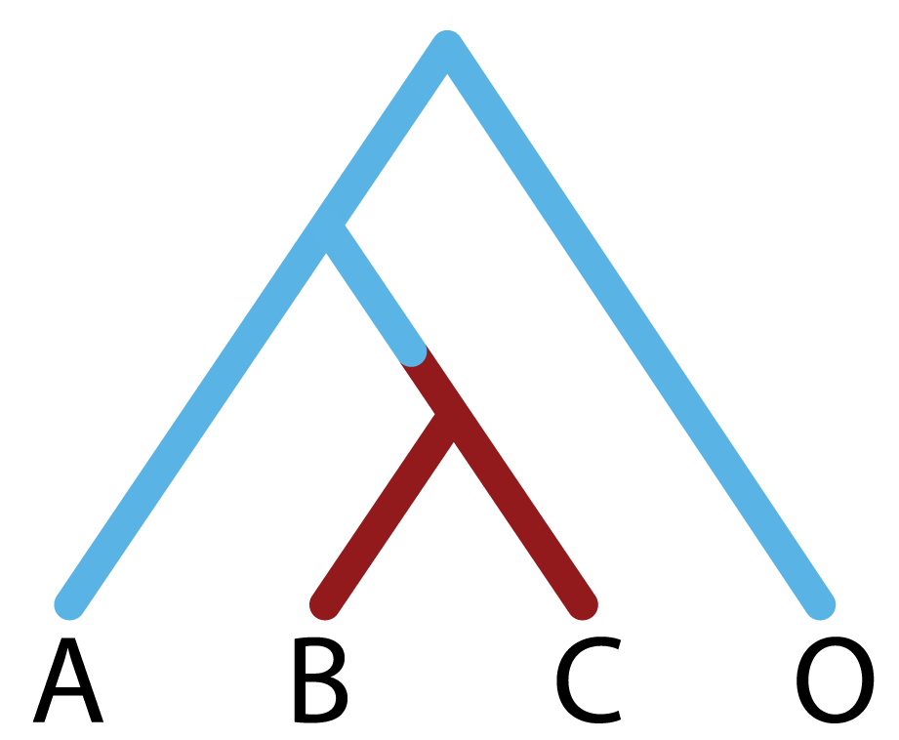
Mapping traits or variation onto a species tree from discordant loci can cause incorrect inferences
Species tree
Gene tree
1 mutation on branch (B,C)
Adapted from Mendes & Hahn 2016
Notes:
Then at this locus we know there is a single mutation that has arisen in the branch leading to B and C, and here I’m just representing this mutation as a change in branch colors. This is, in truth, one mutation.

Slide 65
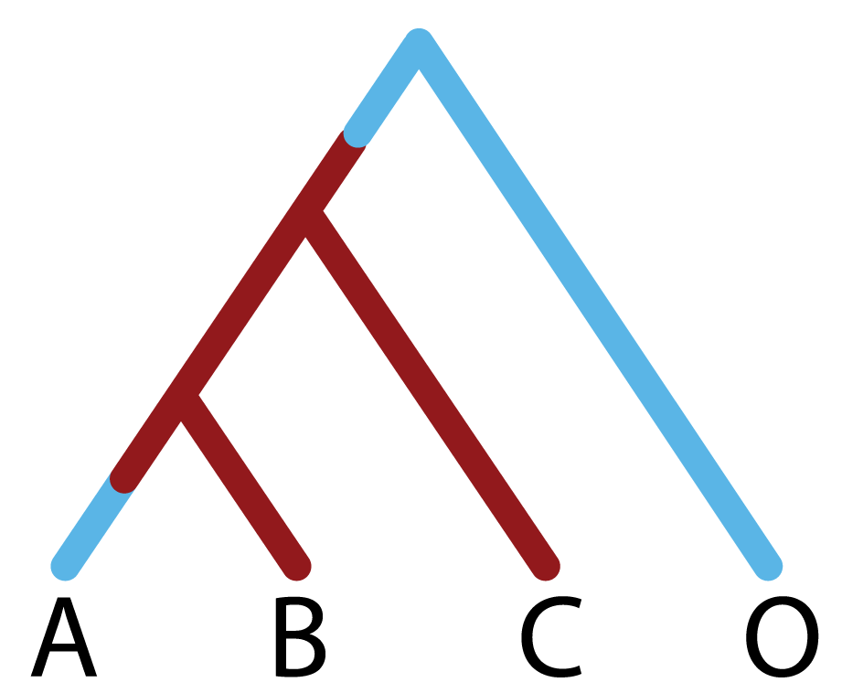
Mapping traits or variation onto a species tree from discordant loci can cause incorrect inferences
Species tree
Gene tree
1 mutation on branch (B,C)
Adapted from Mendes & Hahn 2016
Notes:
But then let’s say we try to make an inference about this mutation using the species tree. The only way to explain lineages B and C sharing this red state is to propose

Slide 66
Mapping traits or variation onto a species tree from discordant loci can cause incorrect inferences
Species tree
Gene tree
1 mutation on branch (A,B,C)
1 mutation on branch (A)
1 mutation on branch (B,C)
Adapted from Mendes & Hahn 2016
Notes:
Multiple mutations, for instance a mutation in the branch ancestor to A B and C, and then a reversion to the ancestral state on branch A.
Of course, we want to use the correct tree when making inferences, which is the gene tree in this context, but in a lot of cases it is still common practice to use a single species tree topology when counting substitutions along a phylogeny.

Slide 67
AACATCGGAGCCA
AACATCGGAGCCA
PhyloAcc v1
AACATCGGAGCCA
Hu et al. 2019
ATCATCGAAGGTA
Accelerated
GACGTCATAGCGC
= Flightless
Accelerated
Notes:
So this was part of the motivation for the next version of PhyloAcc, where instead of only considering the species tree,

Slide 68


AACATCGGAGCCA
AACATCGGAGCCA
AACATCGGAGCCA
Yan et al. in prep
ATCATCGAAGGTA
Accelerated
GACGTCATAGCGC
= Flightless
Accelerated
Notes:
We also estimate a distribution of gene trees for each locus to better account for phylogenetic discordance, which should improve accuracy when identifying elements with accelerated rates of evolution.

Slide 69
AACATCGGAGCCA
713 out of 806 originally found to be accelerated in ratites are still found when using the gene tree model
AACATCGGAGCCA
AACATCGGAGCCA
Yan et al. in prep
ATCATCGAAGGTA
Accelerated
GACGTCATAGCGC
= Flightless
Accelerated
Notes:
And we can already tell this method is having an affect on our results. As Han mentioned, when she re-ran this on the ratite dataset, only 713 out of the original 806 accelerated elements are still found to be accelerated when using the gene tree model. So accounting for discordance is hopefully eliminating these as false positives.

Slide 70
AACATCGGAGCCA
713 out of 806 originally found to be accelerated in ratites are still found when using the gene tree model
AACATCGGAGCCA
AACATCGGAGCCA
Gene tree models take much longer to run
Yan et al. in prep
ATCATCGAAGGTA
Accelerated
GACGTCATAGCGC
= Flightless
Accelerated
Notes:
However, unfortunately, as with most Bayesian phylogenetic methods, this takes much longer to run because we’re now having to infer gene trees for each locus in addition to estimating substitution rates.

Slide 71
Runtime for Bayesian phylogenetic inference can be exorbitant
1 hour per locus
(4 threads)
284,000 loci
Sackton et al. 2019
Notes:
To give you an idea of the scale of this problem: if we take our 284,000 non-coding elements from the ratite dataset, each locus takes about 1 hour to run through the gene tree model with 4 threads.

Slide 72
Runtime for Bayesian phylogenetic inference can be exorbitant
1 hour per locus
(4 threads)
284,000 loci
32 years
Sackton et al. 2019
Notes:
This means running all of these loci in serial would take 32 years to complete the entire dataset….

Slide 73
Runtime for Bayesian phylogenetic inference can be exorbitant
15 minutes per locus
(16 threads)
284,000 loci
8 years
Sackton et al. 2019
Notes:
Increasing to 16 threads shortens the runtime to 15 minutes per locus, but still takes 8 years

Slide 74
Runtime for Bayesian phylogenetic inference can be exorbitant
2 minutes per locus
(128 threads)
284,000 loci
1 year
Sackton et al. 2019
Notes:
And if this continues to scale linearly, even if we could give 128 threads to each locus, at 2 minutes runtime a piece this still would take about a year to complete…. Obviously this is not tractable.

Slide 75
Runtime for Bayesian phylogenetic inference can be exorbitant
Some algorithms are inherently computationally intensive
2 minutes per locus
(128 threads)
284,000 loci
1 year
Sackton et al. 2019
Notes:
And this isn’t to say that the underlying code is insufficient or un-optimized, but rather that some algorithms are inherently computationally intensive. Bayesian phylogenetics is well-known for this, and its our job to try and figure out other ways to reduce run-time and energy costs.

Slide 76
Goals for efficiency and usability
Notes:
So another big aspect of the development of PhyloAcc version 2 is computational efficiency and usability.

Slide 77
Goals for efficiency and usability
Use phylogenetic signal from the data to inform model selection with site concordance factors
Goal 1:
Notes:
And for this we had 2 goals: one, we want to use some signal from the data we already have to inform our model selection. Basically, not every locus necessarily needs to be run through the gene tree model, so we want to figure out a way to find the ones that need it the most and then we can use the faster species tree model for all the rest.

Slide 78
Goals for efficiency and usability
Use phylogenetic signal from the data to inform model selection with site concordance factors
Goal 1:
Facilitate batching of loci for parallel runs on HPCs
Goal 2:
Notes:
And 2, we want to help the user to allocate their resources as well, which means batching loci into common run types that can be submitted in parallel to a cluster.

Slide 79
Goals for efficiency and usability
Use phylogenetic signal from the data to inform model selection with site concordance factors
Goal 1:
Facilitate batching of loci for parallel runs on HPCs
Goal 2:
Notes:
So, first I’ll tell you about how we used concordance factors to inform model selection.

Slide 80
Site concordance factors measure phylogenetic discordance
Concordant
Discordant 1
Discordant 2
Notes:
So, back to our example trees…

Slide 81
Site concordance factors measure phylogenetic discordance
Concordant
Discordant 1
Discordant 2
A | G | A | C | G | A | G | G | T
B | G | A | A | T | A | T | G | T
C | T | A | C | G | C | T | G | T
D | T | A | C | T | C | G | G | A
Notes:
We can get an idea how concordant the underlying sequence is by simply looking at the alignment. SO here is a small cartoon alignment, where rows correspond to the sequences of the tips in the trees, and columns to sites in the alignment.

Slide 82
Site concordance factors measure phylogenetic discordance
Concordant
Discordant 1
Discordant 2
A | G | A | C | G | A | G | G | T
B | G | A | A | T | A | T | G | T
C | T | A | C | G | C | T | G | T
D | T | A | C | T | C | G | G | A
Notes:
And when we do that we see that there are site patterns that can exist in an alignment that reflect each of the three possible topologies around a quartet of species. Some of them being concordant with the species tree

Slide 83
Site concordance factors measure phylogenetic discordance
Concordant
Discordant 1
Discordant 2
A | G | A | C | G | A | G | G | T
B | G | A | A | T | A | T | G | T
C | T | A | C | G | C | T | G | T
D | T | A | C | T | C | G | G | A
Notes:
And others that imply discordant topologies.

Slide 84
Site concordance factors measure phylogenetic discordance
Concordant
For each branch in the species tree:
$$sCF_{quartet}=\frac{Number of alignment sites with concordant grouping }{Total number of decisive alignment sites}$$
Minh et al. 2019, IQ-TREE 2
A | G | A | C | G | A | G | G | T
B | G | A | A | T | A | T | G | T
C | T | A | C | G | C | T | G | T
D | T | A | C | T | C | G | G | A
Notes:
So we can summarize concordance for a given quartet, by simply counting all of the concordant site patterns in the alignment and dividing by the total number of decisive alignment sites. This is called the site concordance factor, and was first implemented by Minh et al. in Iqtree 2 where it is used to summarize discordance across loci for branches in a species tree.
But instead of averaging over all loci, here we re-implement this calculation, but summarize sCF for every locus in the dataset. Then we can use that concordance factor to tell us whether we need to run each locus through the computationally intensive gene tree model or if the faster species tree model will suffice.

Slide 85
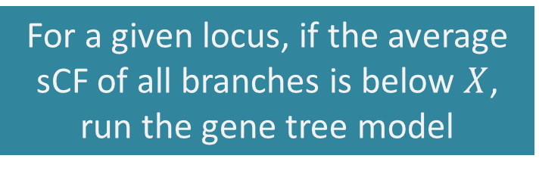
Using average site concordance to partition loci to different phylogenetic models
For a given locus, if the average sCF of all branches is below $X$, run the gene tree model
Notes:
And we’ve implemented a couple of ways to use sCF to help here, but in the interest of time I’ll only talk about one.
So for each locus, we can calculate sCF for every branch in the tree and then average all sCF values to get an overall sCF for the locus itself.
Then we can decide on some cutoff and run every locus below this cutoff, the most discordant loci, through the gene tree model, and all others through the species tree model.

Slide 86
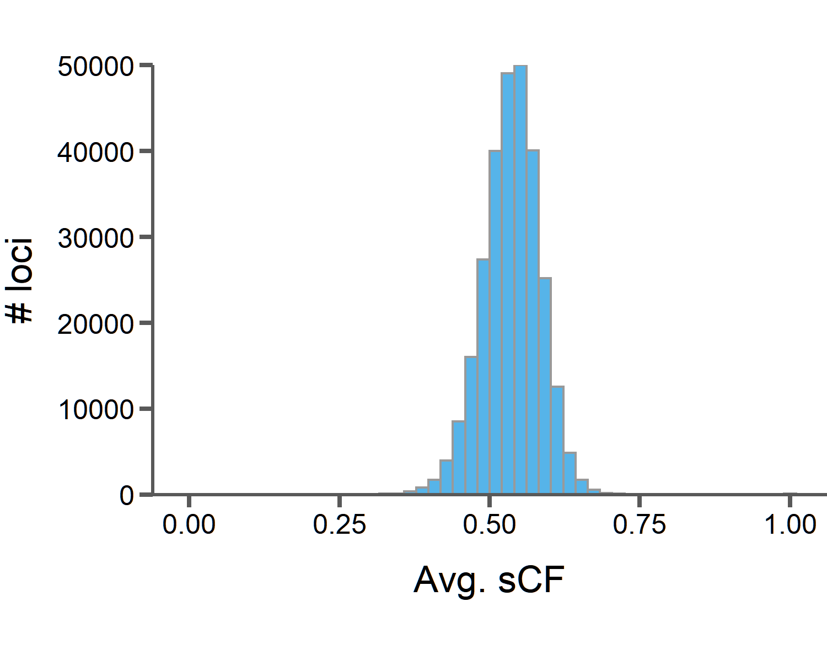
Using average site concordance to partition loci to different phylogenetic models
For a given locus, if the average sCF of all branches is below $X$, run the gene tree model
Notes:
And when we do this for the 284000 loci in the ratite dataset, we see this distribution of average sCF values over all loci. On average, a given element in this dataset has an sCF of just over 0.5, meaning over 50% of sites support the species tree for most branches in the alignment.
Then if we pick a cutoff, X, and say all genes with average sCF below this cutoff will be run with the gene tree model and all others with the species tree model, we can see how this effects runtime for the whole dataset.

Slide 87
Using average site concordance to partition loci to different phylogenetic models
For a given locus, if the average sCF of all branches is below $X$, run the gene tree model
Avg. sCF = 0.4
1,659 loci for gene tree model
17 days with 16 threads
Notes:
For example, if we have a cutoff of 0.4, that means only 1659 loci will be run through the gene tree model, and if they are run serially with 16 threads each, that means these will finish in just over 2 weeks. Still a significant amount of time, but way better than the years it would take to run all loci with the gene tree model.

Slide 88
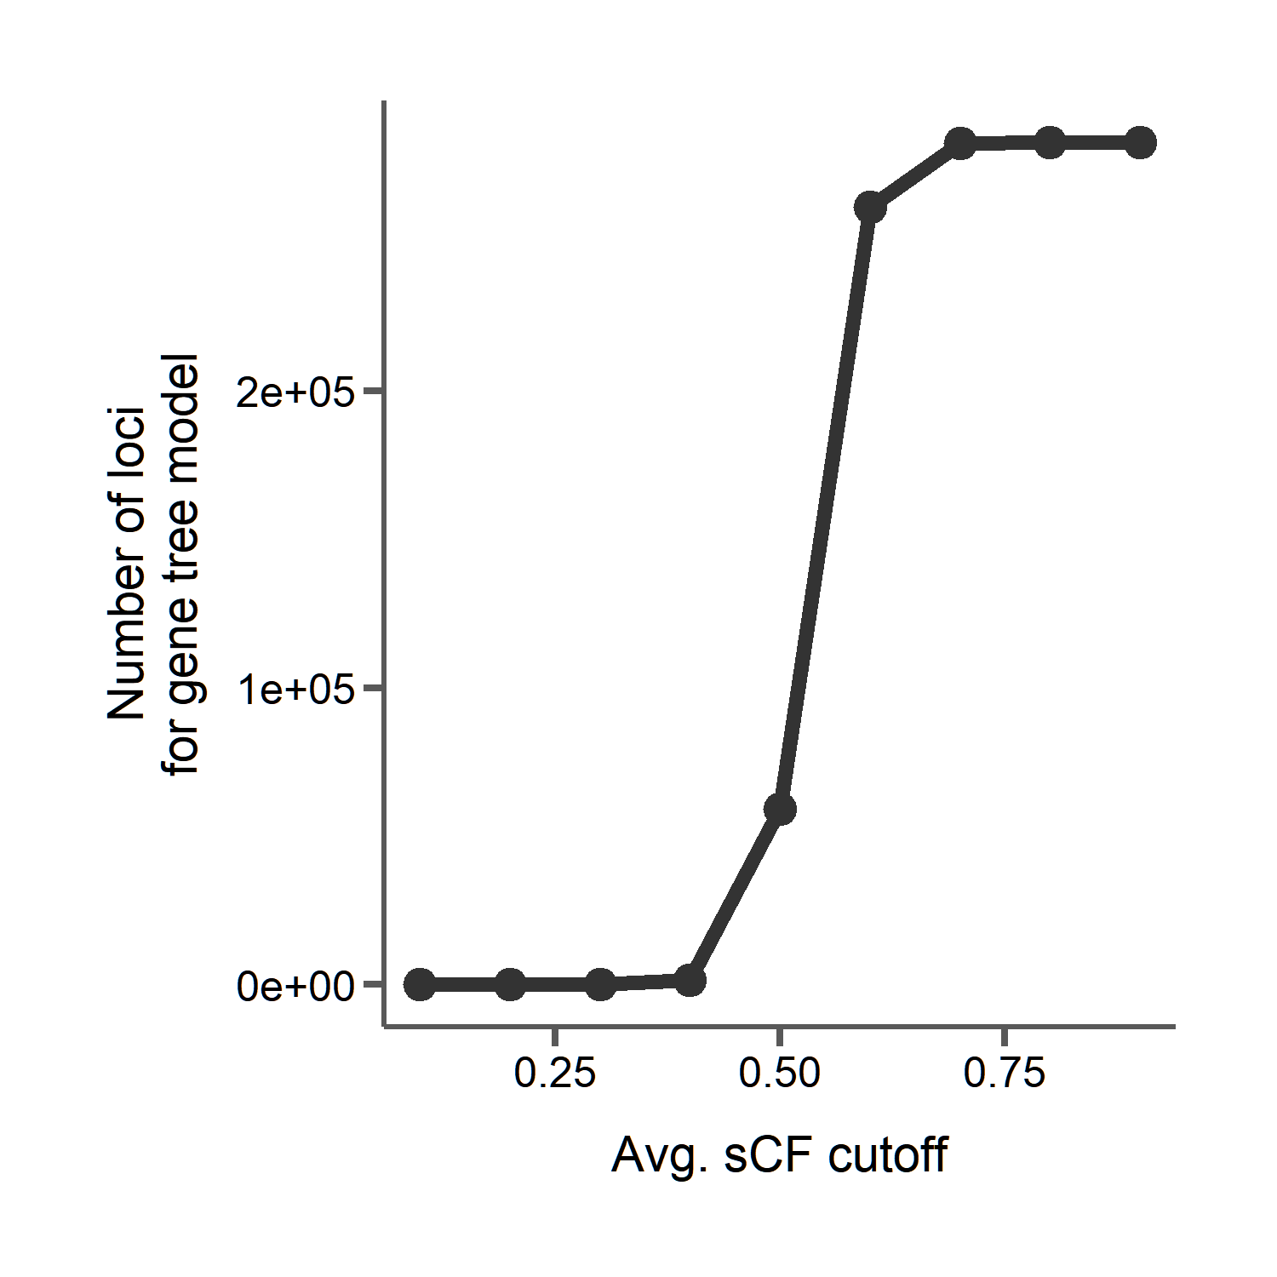
Using average site concordance to partition loci to different phylogenetic models
Notes:
And we can try different cutoffs to see how many loci would then be run through the gene tree model. Lower cutoffs mean fewer genes, with a big jump around the average since that distribution was pretty normal with a small variance.

Slide 89
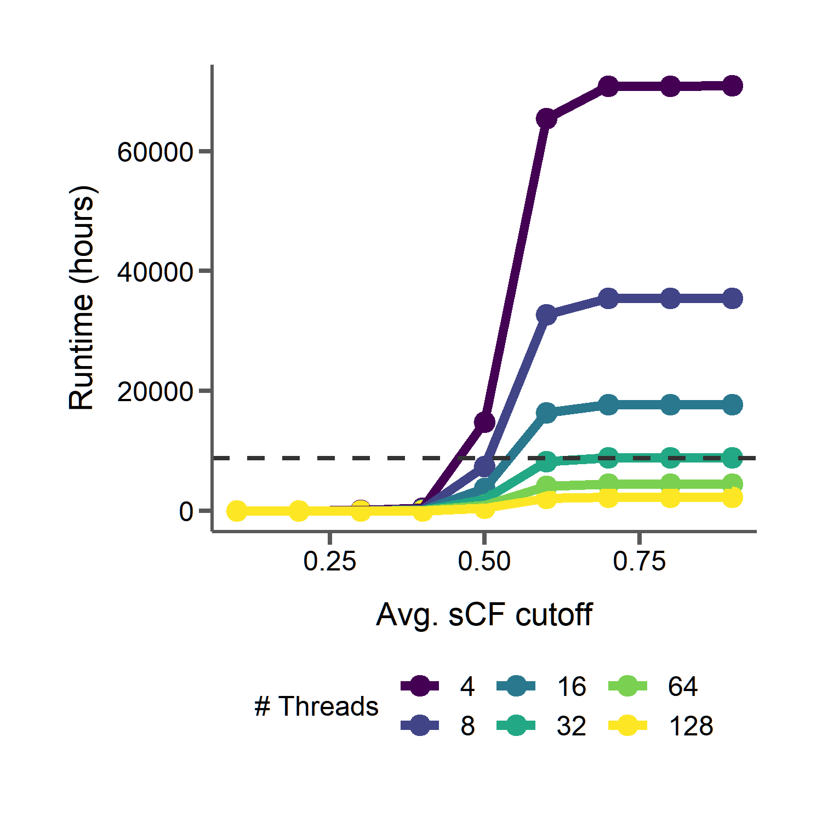
Using average site concordance to partition loci to different phylogenetic models
1 year
Notes:
And we can see here that, with a low enough cutoff, we’re reducing runtimes drastically, and when they are low the importance of the number of threads, which are represented by the different colored lines here, matters less and less.

Slide 90
Goals for efficiency and usability
Use phylogenetic signal from the data to inform model selection with site concordance factors
Goal 1:
Facilitate batching of loci for parallel runs on HPCs
Goal 2:
Notes:
This is how we can use the underlying data to help inform our model selection with PhyloAcc, and we’re thinking of other ways to do this as well

Slide 91
Not all situations require the most complicated model
Goals for efficiency and usability
Use phylogenetic signal from the data to inform model selection with site concordance factors
Goal 1:
Facilitate batching of loci for parallel runs on HPCs
Goal 2:
Notes:
But an important general message that we want to convey is that not all situations require the most complicated model.

Slide 92
Not all situations require the most complicated model
Goals for efficiency and usability
Use phylogenetic signal from the data to inform model selection with site concordance factors
Goal 1:
Trade years of CPU time for ~1 hour to calculate sCF
Drastically reduce the number of compute cycles and energy used
Facilitate batching of loci for parallel runs on HPCs
Goal 2:
Notes:
Using the data you have to look for signals that can inform model selection can help to reduce runtime and conserve energy when processing large datasets. Here, we’ve traded years of compute time for under an hour of calculating concordance factors.

Slide 93
Not all situations require the most complicated model
Goals for efficiency and usability
Use phylogenetic signal from the data to inform model selection with site concordance factors
Goal 1:
Trade years of CPU time for ~1 hour to calculate sCF
Drastically reduce the number of compute cycles and energy used
No need to pre-estimate gene trees
Facilitate batching of loci for parallel runs on HPCs
Goal 2:
Notes:
And site concordance factors are perfect for this because we have no need to transform the data that we already have as input for PhyloAcc.

Slide 94
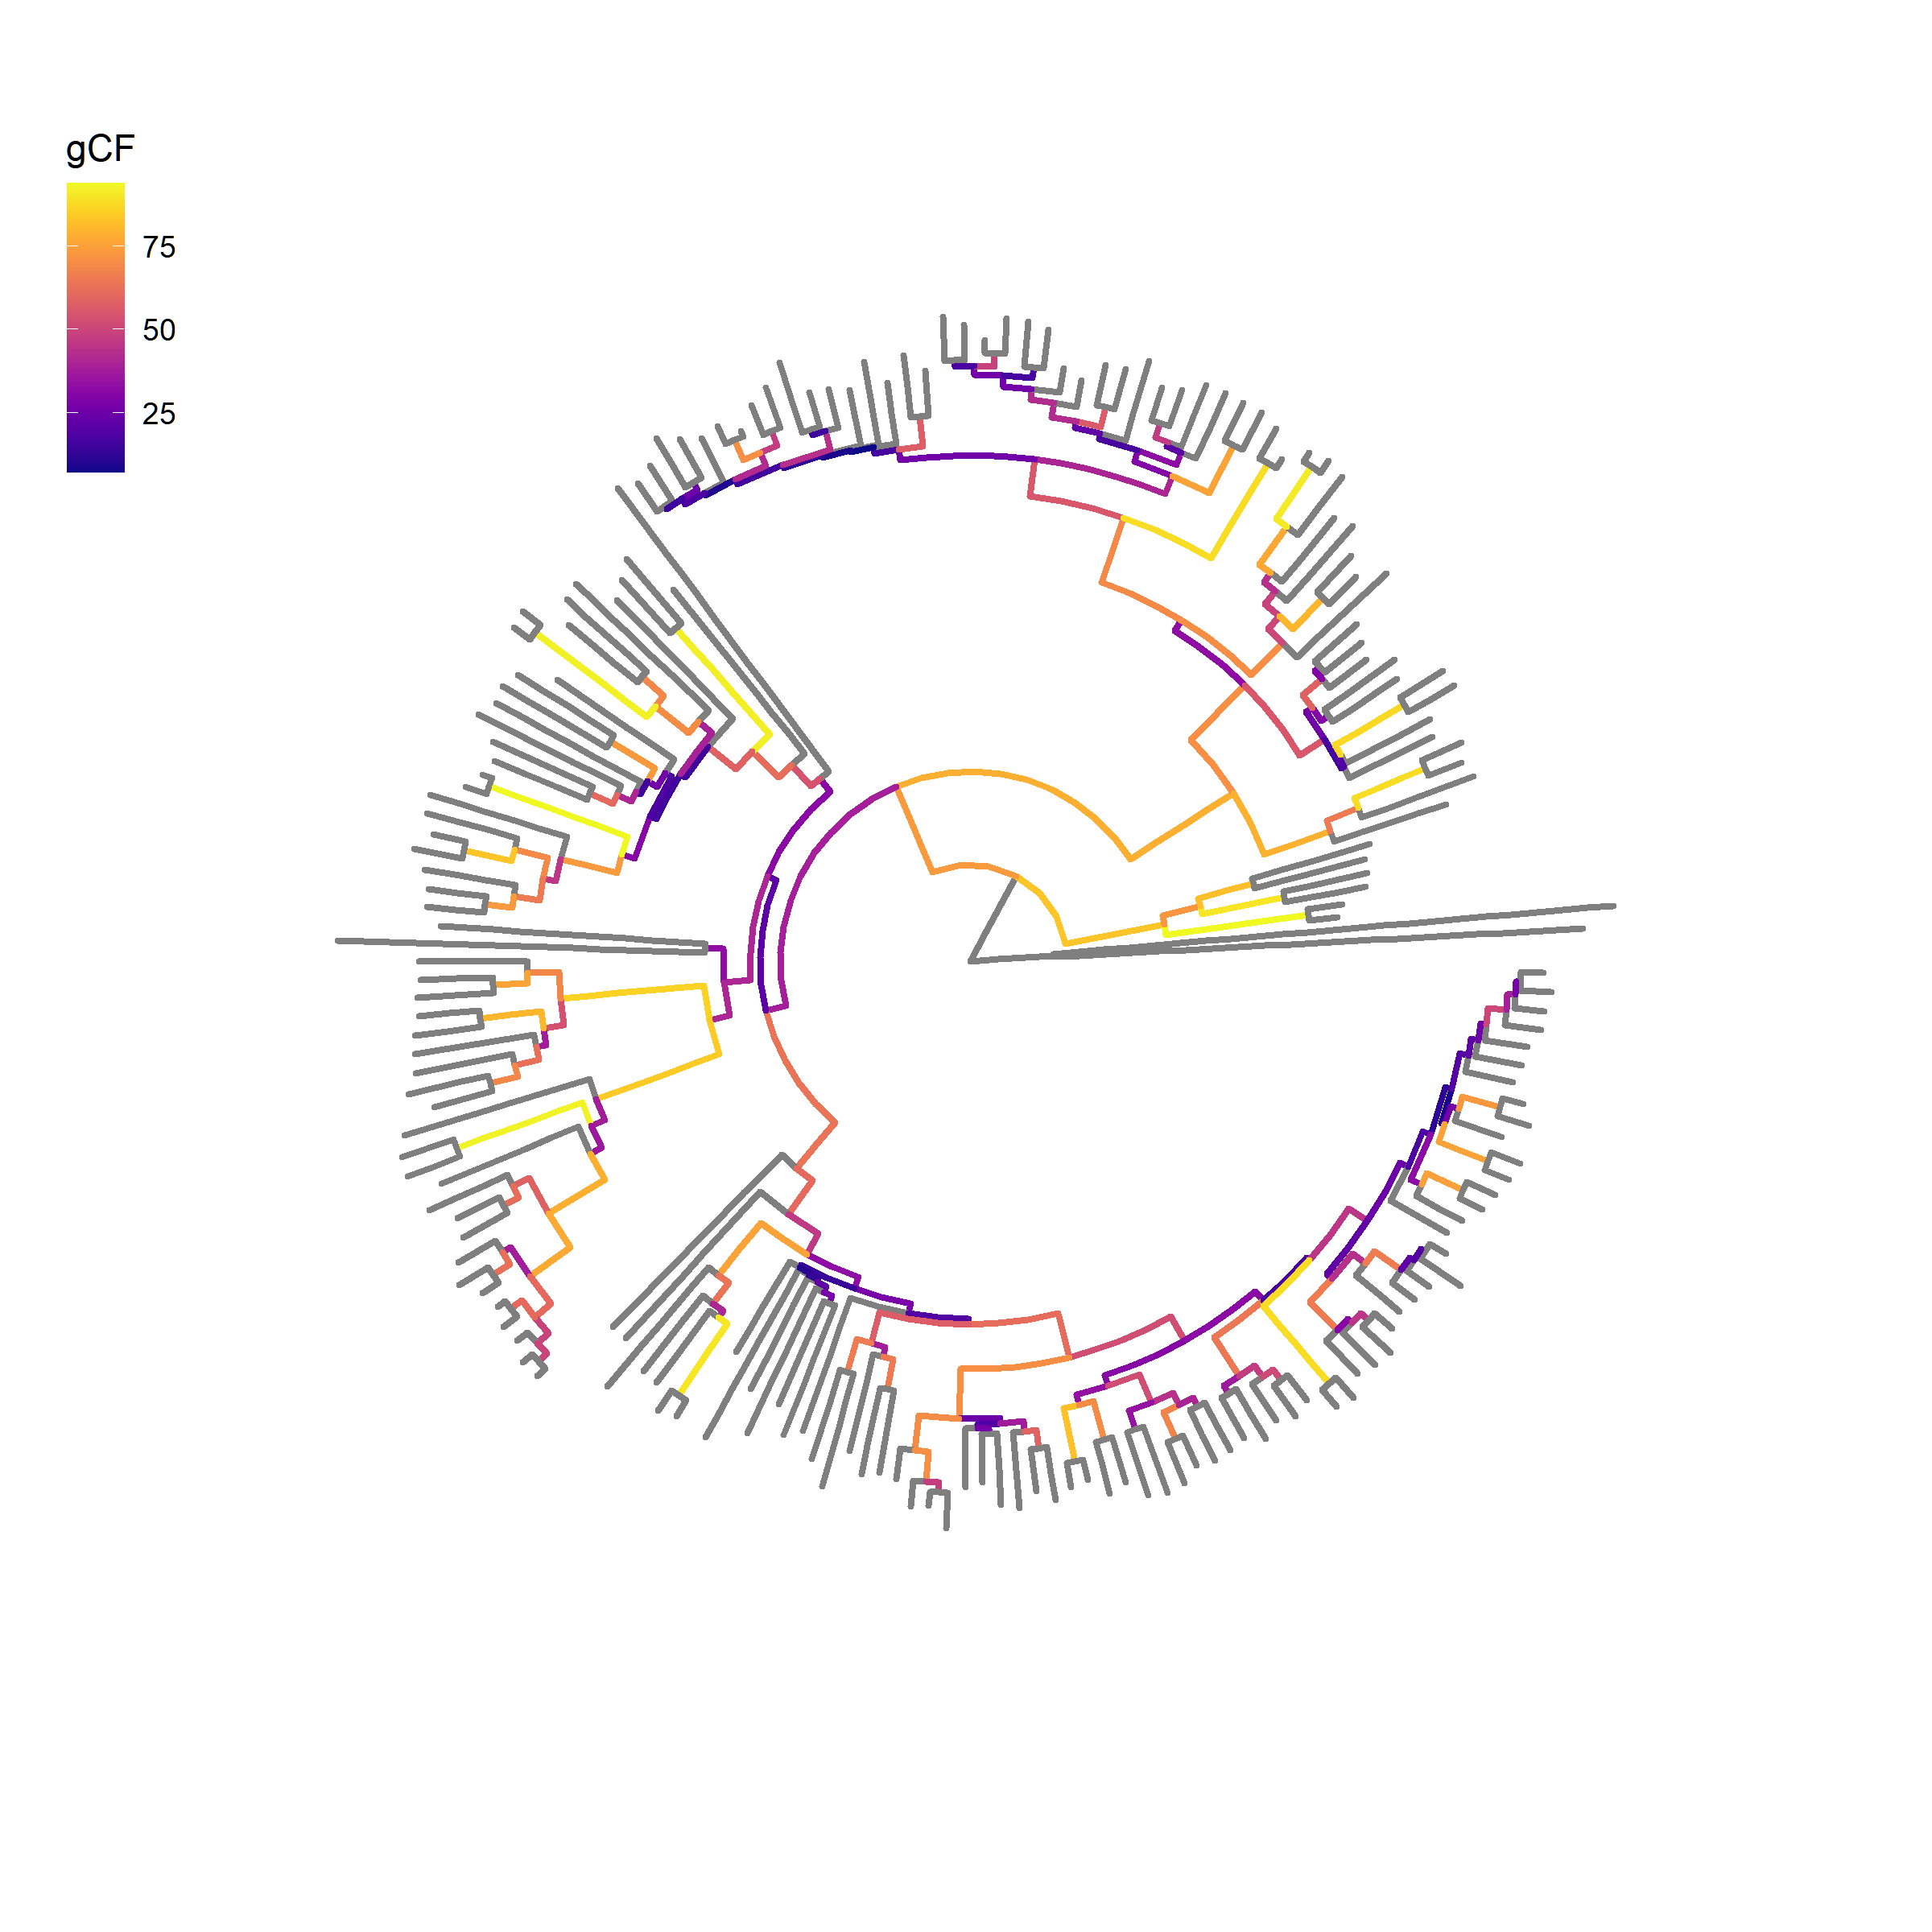
Concordance factors can also be used to reduce tree-size
~12,000 genes
188 species rodent phylogeny
Notes:
And we can use concordance factors in other ways to improve tractability of large datasets. For PhyloAcc we’ve been using them to inform model selection for our input alignments, but we could also use them to help decide which branches of the tree are concordant in most genes and then prune the tree accordingly.
For instance, in another project we have a large phylogeny of 188 rodents and we’d like to estimate substitution rates for 12,000 genes, and here is the tree with branches colored by concordance factor. So if we wanted to process all 12,000 alignments on such a large tree the analysis could take weeks or even months.

Slide 95
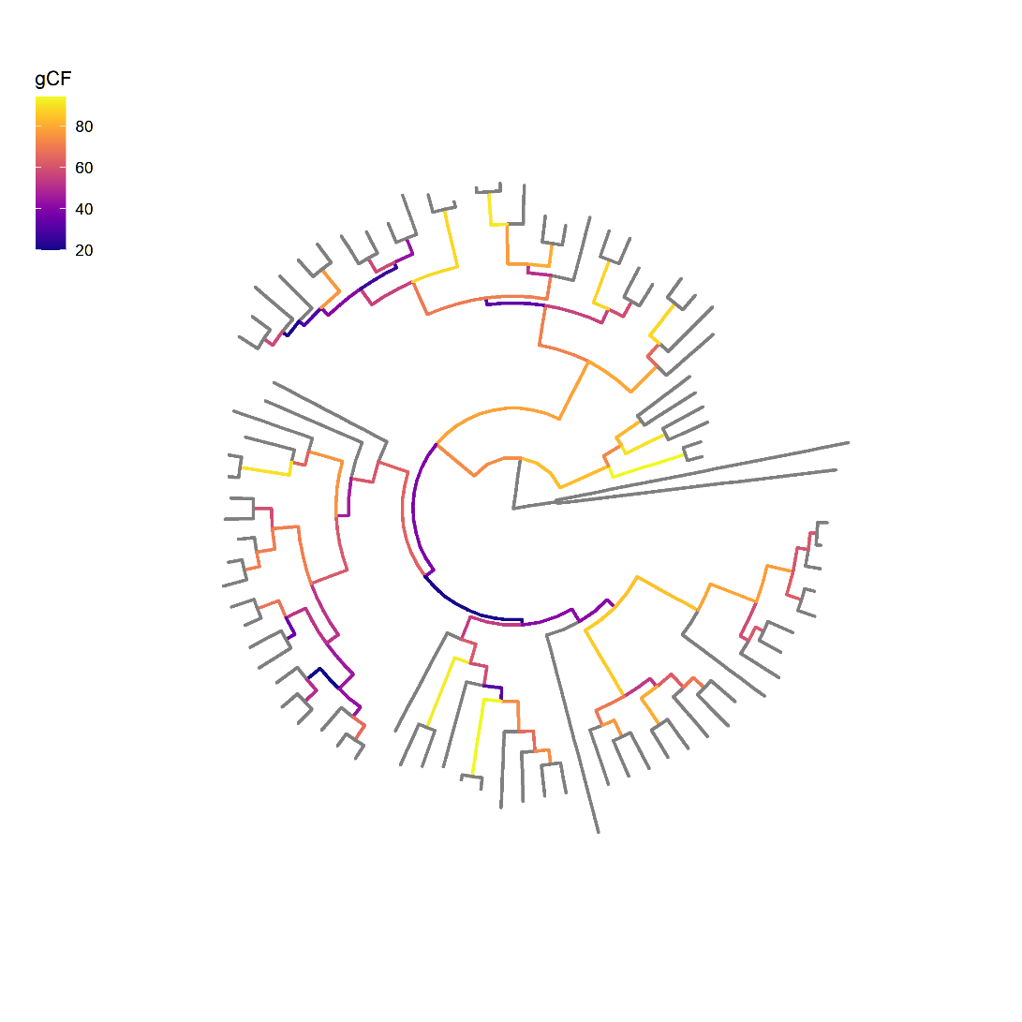
Concordance factors can also be used to reduce tree-size
~12,000 genes
Prune based on concordance and branch length
188 species rodent phylogeny
83 species pruned rodent phylogeny
Notes:
But using concordance factors along with branch lengths to inform tree pruning we can reduce the tree size while keeping the branches that are most concordant, consequently reducing runtime for our analyses.

Slide 96

Concordance factors can also be used to reduce tree-size
~12,000 genes
Prune based on concordance and branch length
https://github.com/gwct/bonsai
188 species rodent phylogeny
83 species pruned rodent phylogeny
Notes:
And this algorithm is being developed in a software package called bonsai, which will have a suite of concordance factor calculations to aid in these sort of analyses. So using the data we have already to inform how we run our analyses can be a big factor in computational efficiency.

Slide 97
Goals for efficiency and usability
Use phylogenetic signal from the data to inform model selection with site concordance factors
Goal 1:
Facilitate batching of loci for parallel runs on HPCs
Goal 2:
Notes:
So, up until now I’ve basically been focused on running each locus with PhyloAcc one at a time, but of course many of us have access to larger compute clusters that allow us to run many loci or batches of loci at once. So that was the second goal for PhyloAcc’s efficiency, to introduce some way to facilitate batching and running on clusters.

Slide 98
Inputs
+
PhyloAcc C++
Rates
Alignments
+
Neutral rates
Notes:
So, originally, the way you’d run PhyloAcc was you’d take all of your alignments and your species tree and feed them to the C++ codebase which would do its work and give you back substitution rates and rate categories. While this is multi-threaded, it didn’t have an easy way to split things up to run multiple loci at once.
This is actually a common theme I’ve observed among bioinformatics software: optimized for a single locus, even though many use cases require them to be run on many thousands of loci. So again, we hope our solution to this problem in the context of PhyloAcc can be easily adaptable to other stuff.

Slide 99
Inputs
+
PhyloAcc
Python interface
Alignments
+
Neutral rates
Notes:
And our solution was to introduce a new layer of Python code that would handle all of the inputs

Slide 100
Gene tree batch
Inputs
Gene tree batch
Species tree batch
Species tree batch
Species tree batch
+
PhyloAcc
Python interface
Alignments
Species tree batch
.
.
.
+
Neutral rates
Filtered loci
Snakemake script for job submission
Notes:
This python interface would do all of the concordance factor calculations I talked about in the first half of the talk in addition to some filtering based on the number of informative sites, and then batch loci together based on which model they are to be run with based on the user’s cutoffs.
This interface also generates a snakemake script that handles all job submission to a cluster.

Slide 101

Gene tree batch
PhyloAcc-GT C++
Inputs
Gene tree batch
PhyloAcc-GT C++
Species tree batch
PhyloAcc C++
Species tree batch
PhyloAcc C++
Species tree batch
PhyloAcc C++
+
PhyloAcc
Python interface
Rates
Alignments
Species tree batch
PhyloAcc-GT C++
.
.
.
+
PhyloAcc C++
Neutral rates
Filtered loci
Snakemake script for job submission
Notes:
Then once the interface is run, the snakefile is executed and runs each job with the appropriate C++ codebase to get the same rates and categories as before.

Slide 102
Gene tree batch
PhyloAcc-GT C++
Inputs
Gene tree batch
PhyloAcc-GT C++
Species tree batch
PhyloAcc C++
Species tree batch
PhyloAcc C++
Species tree batch
PhyloAcc C++
+
PhyloAcc
Python interface
Rates
Alignments
Species tree batch
PhyloAcc-GT C++
.
.
.
+
PhyloAcc C++
Neutral rates
Filtered loci
Snakemake script for job submission
Notes:
Except I want to note in this one case, where we send a batch designated for the species tree model to the gene tree codebase, and this can be done if you want to get an idea of a possible false negative rate.
And this all works out because we’re using these tools for what they’re optimized for. C++ is great and fast for the numerical calculations required by the Bayesian model. Python is great at handling files and strings like trees, and snakemake is made for workflow management. This also gives us the flexibility to add new features at the appropriate level in the future. So this design is really taking advantage of each tool’s strengths. And as a result we get much faster runtimes and more ease of use than if everything were packaged into just python or C++.

Slide 103
Batching loci by model type can also drastically reduce runtime for PhyloAcc
1 year
Notes:
So recall, if we use average sCF as a cutoff to decide how many loci are run through the gene tree model, and we run all loci one after another, we get these runtimes. With a low enough cutoff, these are reasonable, but can still be on the order of weeks. And with higher cutoffs these are excessive.

Slide 104
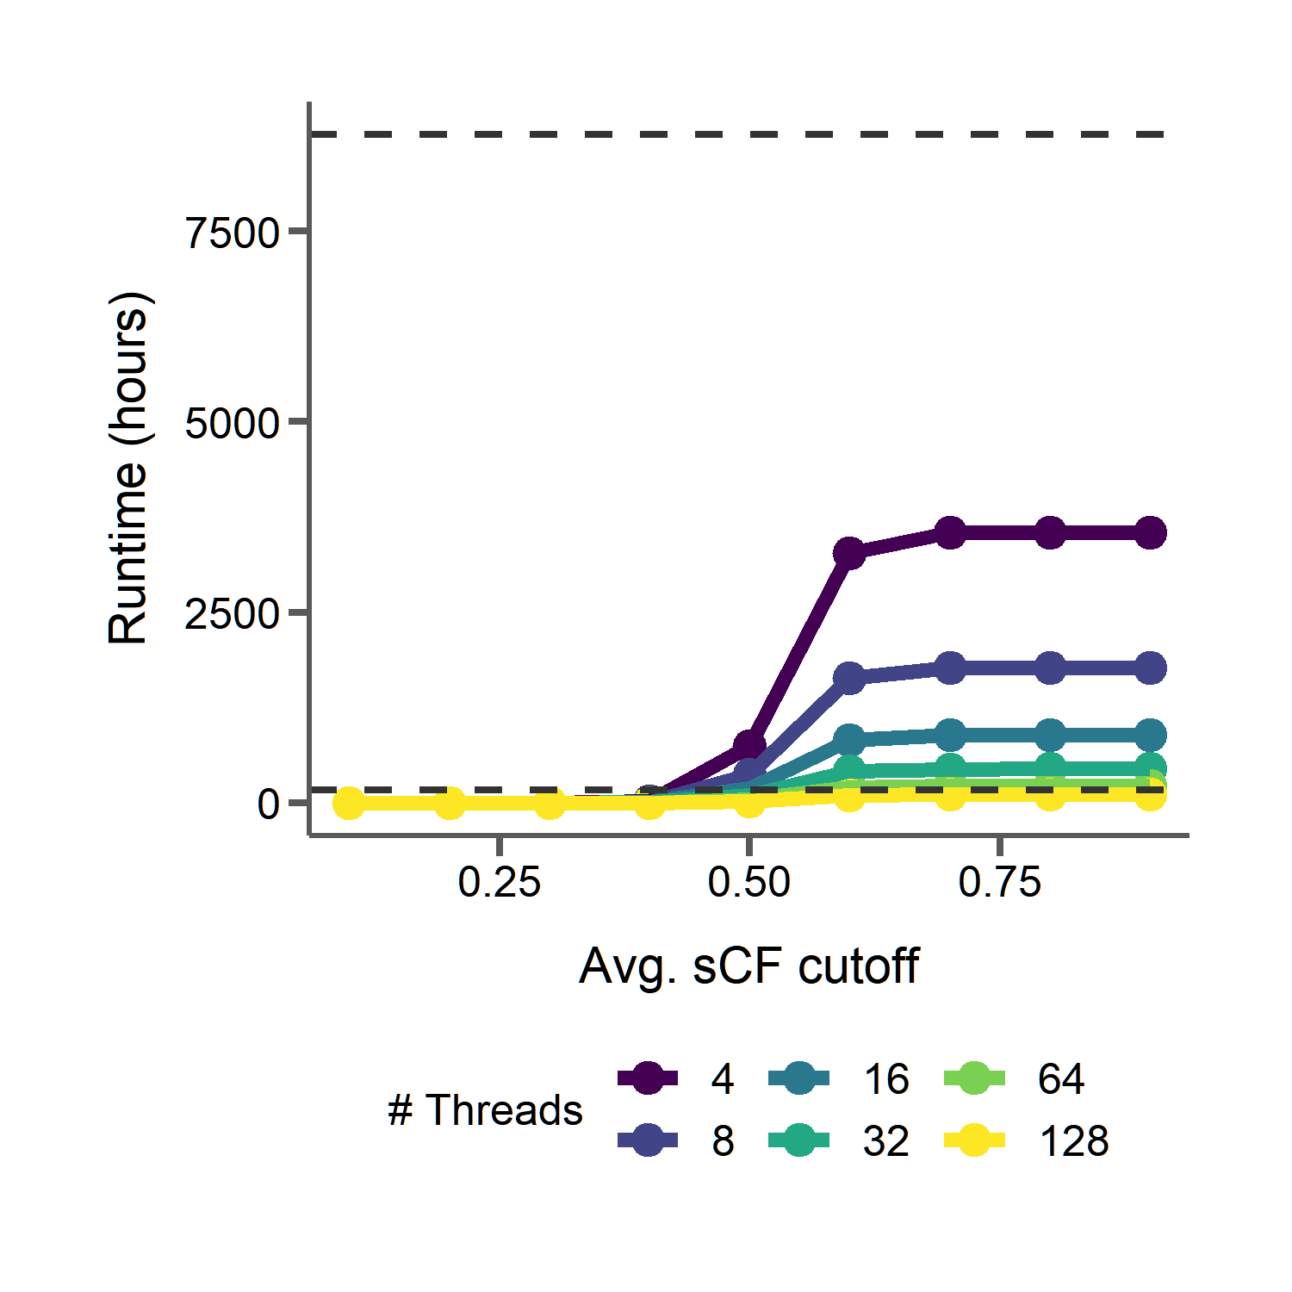
Batching loci by model type can also drastically reduce runtime for PhyloAcc
1 year
20 batches
1 year
1 week
Notes:
Now, if we use the interface to batch all the gene tree loci and run them 20 at a time, this is reduced even more, in many cases taking only a few days to run completely.

Slide 105
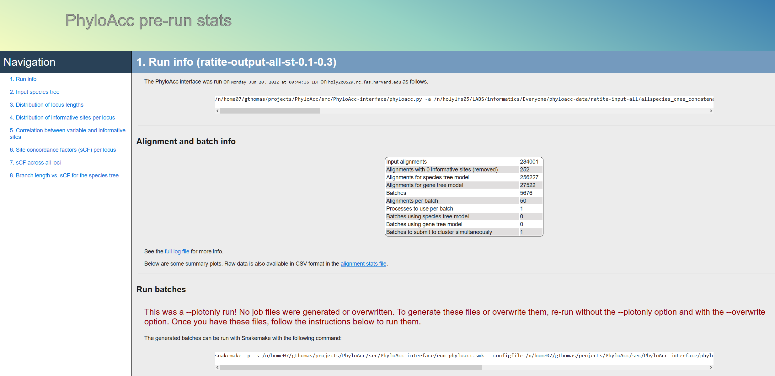
Notes:
The interface has a ton of new ease of use features as well, including summary html files both before and after running PhyloAcc with tables and plots and even instructions on how to execute the workflow.

Slide 106
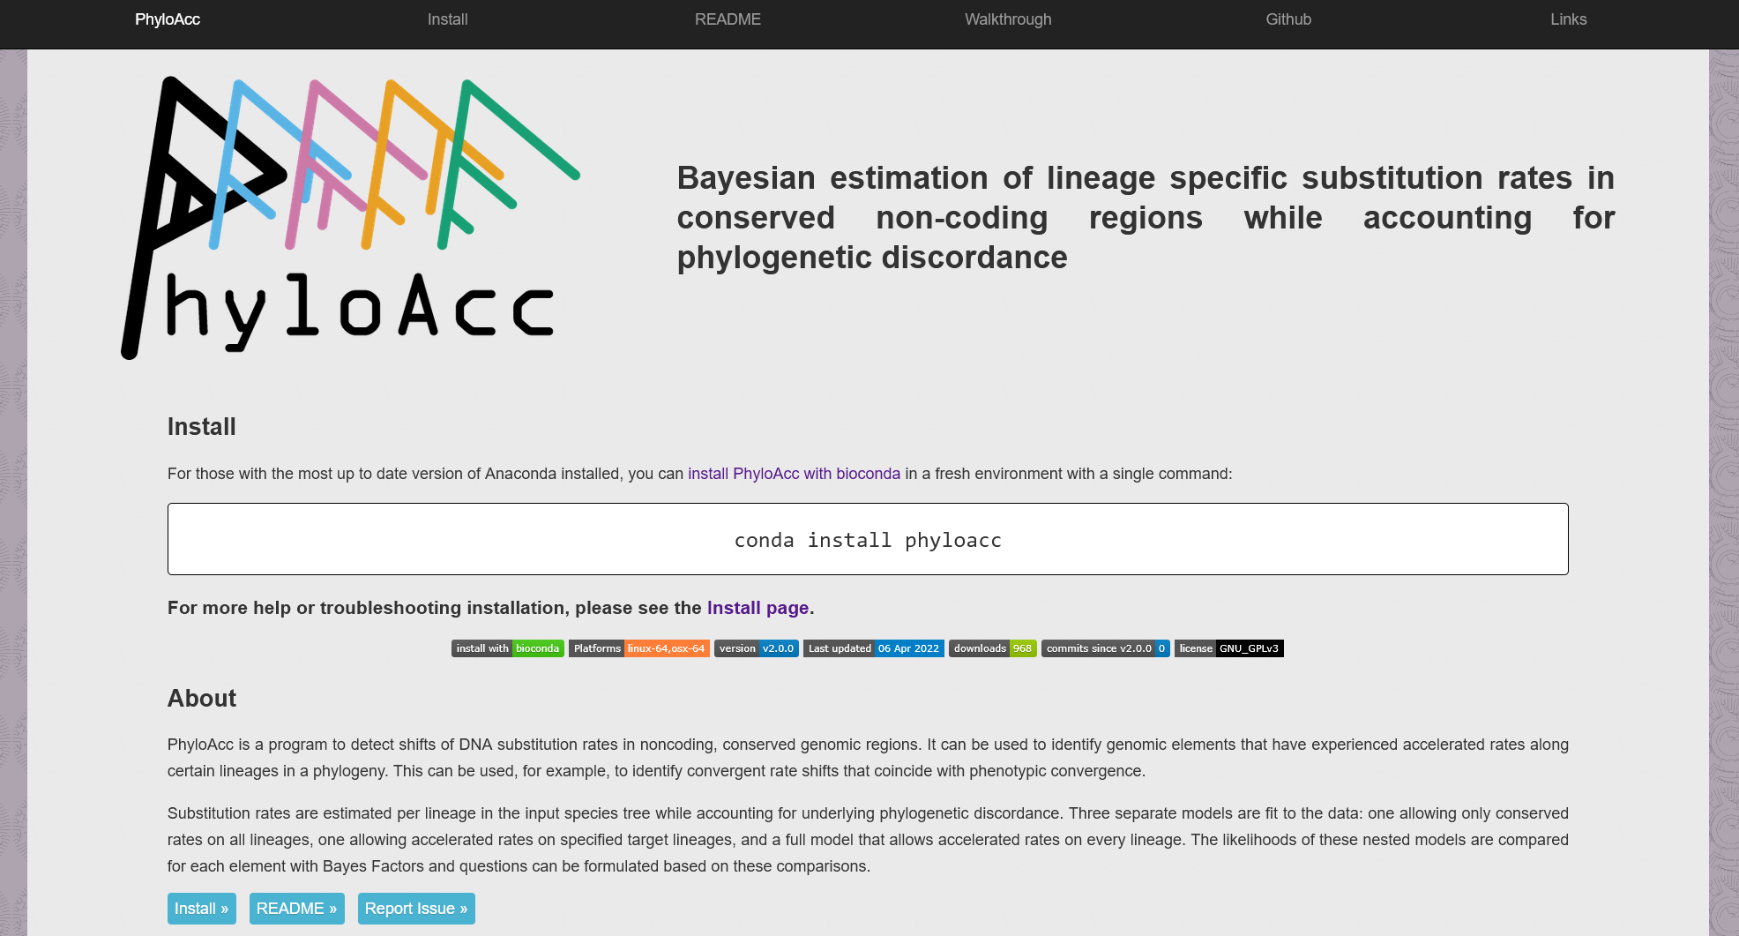
https://phyloacc.github.io/
Notes:
And of course we want everything to be documented and reproducible, so we have a new webpage. This is still under construction as we speak but should be complete soon. But I want to highlight that we wanted to overcome another headache that users might have: installation. Installing and building from source can be a pain, especially with all the dependencies we have, so we now package everything with conda, which if you already have setup PhyloAcc can be installed with this one command. If not we provide more instructions on the install page. We currently have builds for Linux and Mac and are working on Windows as well.

Slide 107






Tim Sackton | Han Yan | Scott Edwards
Zhirui Hu | Jun Liu | Nathan Weeks
Patrick Gemmell | Taehee Lee | Subir Shakya
Adam Freedman | Danielle Khost | Daren Card
Acknowledgements
Jeff Good | Emily Kopania | Carl Hutter
Jake Esselstyn | Kevin Rowe | Sebastian Mortimer
Clara Boothby
Notes:
But with that…

Slide 108
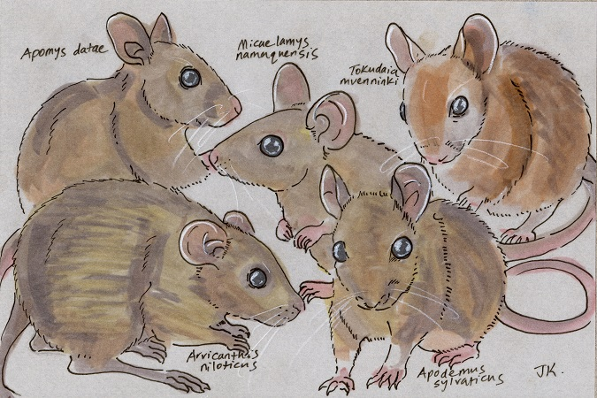
Thanks
Molecular and morphological evolution across the most species-rich radiation in mammals (Poster board 105) TODAY!
http://dailymammal.com/murines-five-ways/

Slide 111
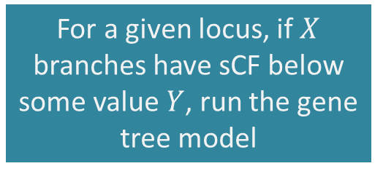
Using branch count thresholds of concordance to partition loci to different phylogenetic models
For a given locus, if $X$ branches have sCF below some value $Y$, run the gene tree model
Option 2:
Notes:
Another way we could decide which loci to give to the gene tree model is to set a threshold of the number of branches that have low sCF. For example, if one third of all branches in a locus have sCF below 0.5, we give that locus to the gene tree model.

Slide 112
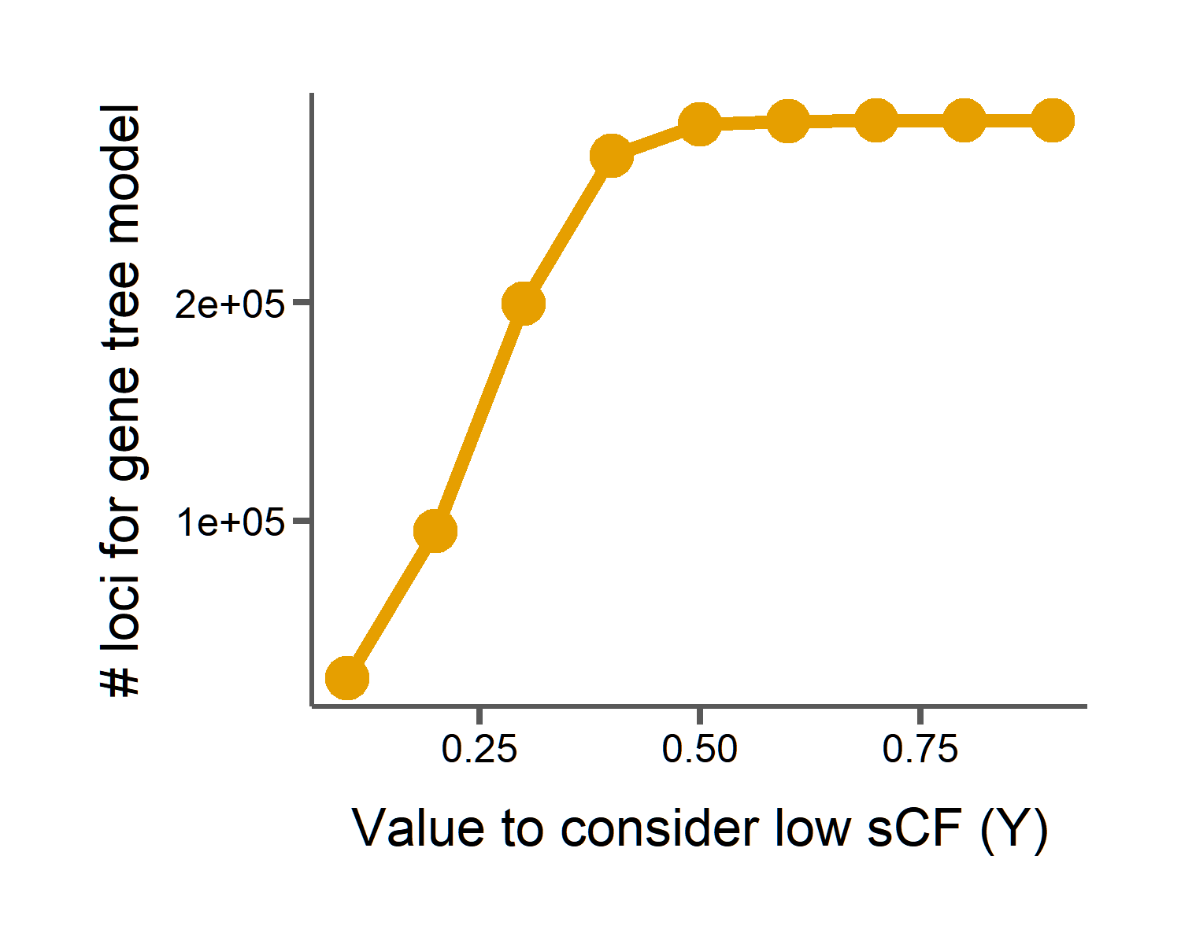
Using branch count thresholds of concordance to partition loci to different phylogenetic models
For a given locus, if $X$ branches have sCF below some value $Y$, run the gene tree model
Option 2:
Notes:
And again, if we set our X here to 0.3 and vary cutoff for low sCF we see dramatic drop-offs in the number of loci we would run with the gene tree model, however not quite as drastic as simply using the average sCF of all branches.

Slide 113
Using branch count thresholds of concordance to partition loci to different phylogenetic models
For a given locus, if $X$ branches have sCF below some value $Y$, run the gene tree model
Option 2:
Low sCF = 0.1
27,522 loci for gene tree model
9.5 months with 16 threads
Notes:
In this case, if our value to consider a branch having low sCF is 0.1, we will still have 27,000 loci for the gene tree model, which when run serially with 16 threads each will take over 9 months to run.

Slide 114
Phylogenies from different loci can disagree with an inferred species tree
Concordant
Discordant 1
Discordant 2
Gene tree 1
Gene tree 2
Gene tree 3
Species tree
Causes of discordance
Gene tree error | Incomplete lineage sorting | Introgression
Notes:
What causes different regions of the genome to have different topologies?
Of course, if we make errors in gene tree estimation, we might get different trees. So we try to minimize that at every step of the way. But discordance can also arise because of biological phenomena.
For instance, variation in ancestral populations leading to incomplete lineage sorting
And introgression between species can both lead to discordant topologies.

Slide 115
Site concordance factors measure phylogenetic discordance
Concordant
Discordant 1
Discordant 2
G | G | C | C
G | G | C | C
G | G | C | C
For each branch in the species tree:
$$sCF_{quartet}=\frac{Number of alignment sites with concordant grouping }{Total number of decisive alignment sites}$$
Notes:
So we can summarize concordance for a given quartet, by simply counting all of the concordant site patterns in the alignment and dividing by the total number of decisive alignment sites. This is called the site concordance factor, and has been used to summarize discordance across loci for branches in a species tree.
But instead of averaging over all loci, here we are going to summarize sCF for every locus in the dataset. Then we can simply summarize sCF for a given alignment and use that concordance factor to tell us whether we need to run this through the computationally intensive gene tree model or if the faster species tree model will suffice.

Slide 116
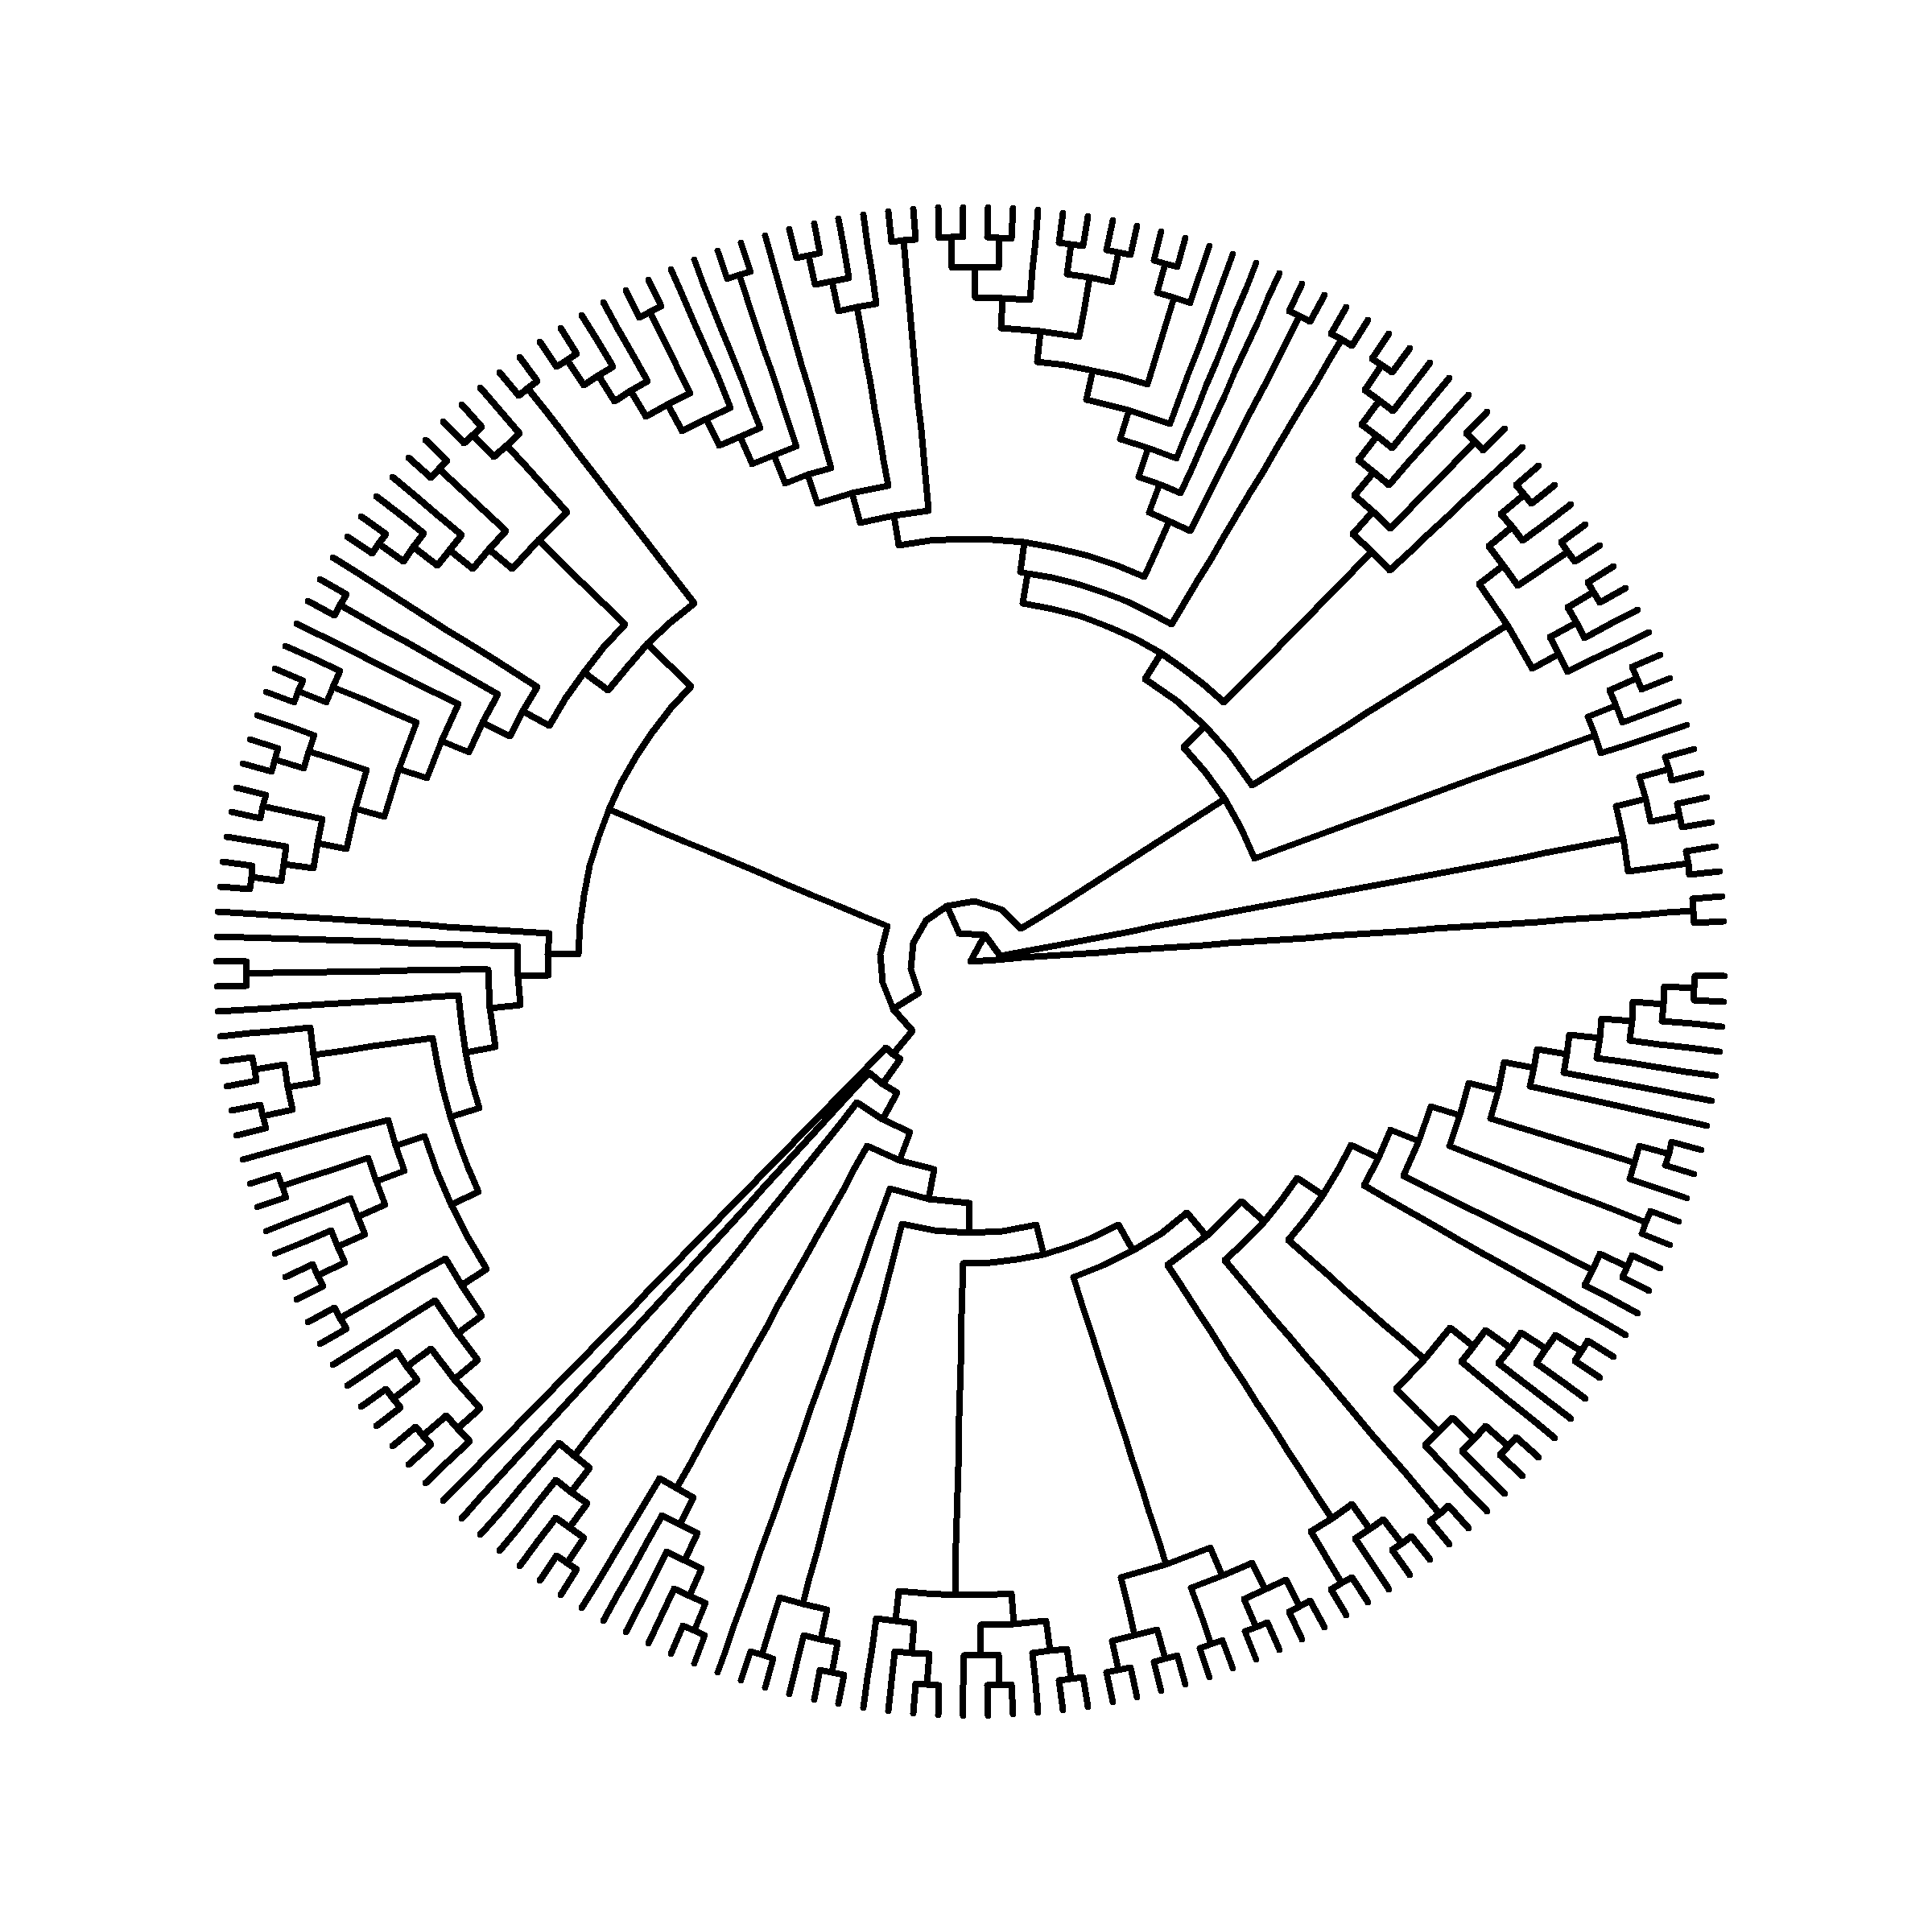
Phylogenetic discordance in rodent exomes
Notes:
And here I’m going to show this pure topological representation of the tree so we can get a closer look without all the sample names that we can’t read anyways cluttering it up. But this is the same inferred tree topology that I showed before.
So, unlike the insect dataset, where we have relatively sparse sampling over deep time, here we’ve got 200 species, which span only 15 million years of evolution.

Slide 117
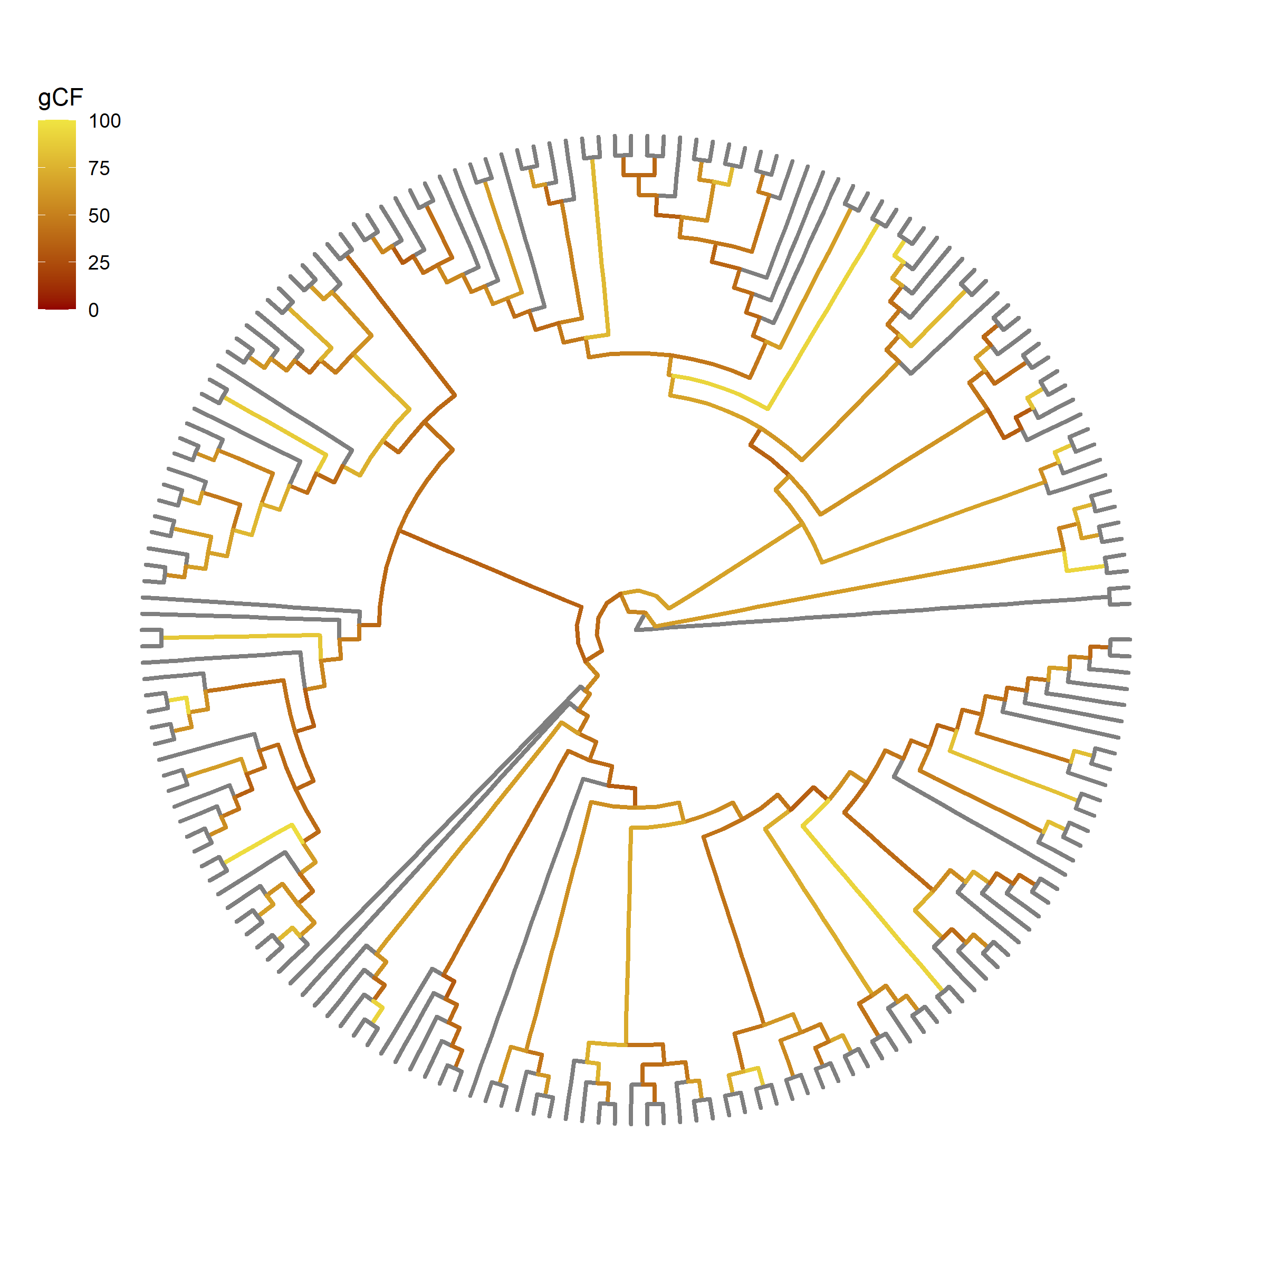
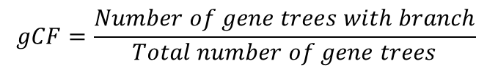
Gene concordance factors (gCF) show extensive discordance among rodent exomes
$$gCF=\frac{Number of gene trees with branch}{Total number of gene trees}$$
Notes:
So here we have lots of discordance. And here I’ve colored the branches by gene concordance factor, which is the percent of gene trees that contain a given branch in the species tree. Sometimes fewer than a quarter of the gene trees support a given branch in the species tree, looking at these really dark branches.
gCF is also a useful tool for detecting the sources of discordance. Using the patterns of the discordant topologies around each branch we can actually test for introgression. And this is a particularly interesting question in rodents, since there’s bound to be lots of secondary contact as species re-colonize or are re-introduced to the islands in Indonesia and the philippines. So we thought that there might be widespread hybridization leading to gene flow in this group.

Slide 118
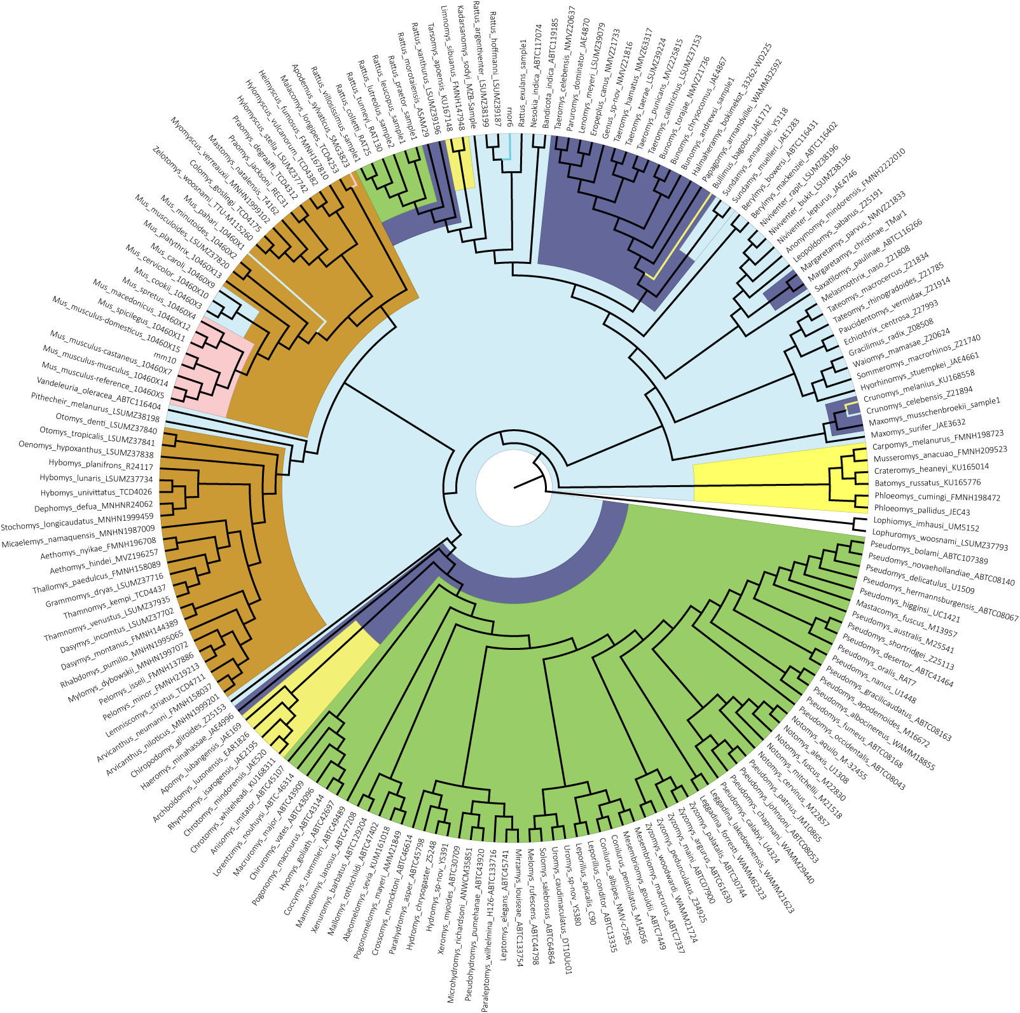
Phylogenetic discordance in rodent exomes
Notes:
Ok, so what does all of this mean for our rodent exomes, where one of our main goals is to infer substitution rates and correlate them with trait evolution.

Slide 119
Phylogenetic discordance in rodent exomes
Notes:
And here I’m going to show this pure topological representation of the tree so we can get a closer look without all the sample names that we can’t read anyways cluttering it up. But this is the same inferred tree topology that I showed before.
So, unlike the insect dataset, where we have relatively sparse sampling over deep time, here we’ve got 200 species, which span only 15 million years of evolution.

Slide 120
Gene concordance factors (gCF) show extensive discordance among rodent exomes
$$gCF=\frac{Number of gene trees with branch}{Total number of gene trees}$$
Notes:
So here we have lots of discordance. And here I’ve colored the branches by gene concordance factor, which is the percent of gene trees that contain a given branch in the species tree. Sometimes fewer than a quarter of the gene trees support a given branch in the species tree, looking at these really dark branches.
gCF is also a useful tool for detecting the sources of discordance. Using the patterns of the discordant topologies around each branch we can actually test for introgression. And this is a particularly interesting question in rodents, since there’s bound to be lots of secondary contact as species re-colonize or are re-introduced to the islands in Indonesia and the philippines. So we thought that there might be widespread hybridization leading to gene flow in this group.

Slide 121

Introgression is limited to only a few murine lineages
Notes:
But as it turns out, we only see significant evidence for introgression in a few lineages, mostly within the large Australian radiation. So it doesn’t look like secondary contact within the Indonesian or Philippine islands happened, or if it did it didn’t lead to lasting gene flow. This means that most of the phylogenetic discordance we observe throughout the tree is likely due to ancestral variation, which makes sense given the rapid speciation that we think occurred among murine rodents.
But based on our previous results, this discordance could cause a lot of problems when counting substitutions along the phylogeny inferring rates of molecular evolution. So how do we deal with this?

Slide 122


How to infer rates while accounting for discordance?
For gene-based inferences use gene trees
Species tree
Gene trees
Notes:
The easiest thing to do when counting substitutions is to just use gene trees for everything. And indeed for any inference of substitution rate we should be using the gene tree. And this works great for gene based analyses – say when we’re asking individually of each gene whether there are indications of positive selection.

Slide 123
How to infer rates while accounting for discordance?
For gene-based inferences use gene trees
For lineage-based inferences use only gene trees that match the species tree?
Species tree
Gene trees
Notes:
But we may still want to count substitutions using gene trees and map these counts back on to species tree to ask which lineages have experienced accelerated evolution. And its in these lineage or branch based analyses that discordance could cause inflations of counts by mis-mapping them onto different topologies.
So we could just use gene trees that exactly match the species tree. This is a simple way of sidestepping this problem, and may work in some instances. But what we’re finding out is that discordance is prevalent in many phylogenomic datasets,

Slide 124

How to infer rates while accounting for discordance?
For gene-based inferences use gene trees
For lineage-based inferences use only gene trees that match the species tree?
Species tree
Gene trees
Notes:
so in most cases this means throwing out a lot of data… every gene tree that doesn’t exactly match the species tree would have to be removed. And if we restrict our inferences in rodents only to those genes that match the species tree, we’ll be throwing away a lot of our data… basically all of it. So we can’t really do that.

Slide 125
How to infer rates while accounting for discordance?
For gene-based inferences use gene trees
For lineage-based inferences use only gene trees that match the species tree?
Species tree
Gene trees
Notes:
so in most cases this means throwing out a lot of data… every gene tree that doesn’t exactly match the species tree would have to be removed. And if we restrict our inferences in rodents only to those genes that match the species tree, we’ll be throwing away a lot of our data… basically all of it. So we can’t really do that.

Slide 126
How to infer rates while accounting for discordance?
For gene-based inferences use gene trees
For lineage-based inferences use only gene trees that match the species tree?
For lineage-based inferences, count substitutions by branch
Species tree
Gene trees
Notes:
Instead, we can count substitutions branch by branch. For each branch in the species tree, we go and find gene trees where that branch exists – where it is not discordant – and then we count all the sites and substitutions across genes for this branch to get a more accurate calculation of rate while keeping a lot more of our data.

Slide 127

How to infer rates while accounting for discordance?
For gene-based inferences use gene trees
For lineage-based inferences use only gene trees that match the species tree?
For lineage-based inferences, count substitutions by branch
Species tree
Gene trees
Notes:
For example, for this yellow branch leading to A and B, we can find

Slide 128

How to infer rates while accounting for discordance?
For gene-based inferences use gene trees
For lineage-based inferences use only gene trees that match the species tree?
For lineage-based inferences, count substitutions by branch
Species tree
Gene trees
Notes:
All the gene trees that also have a branch leading to A and B and count substitutions along those. And we lose much less data, only this tree here that doesn’t have that branch. But this tree isn’t excluded completely… it can still be counted for the other species tree branches it does contain

Slide 129

How to infer rates while accounting for discordance?
For gene-based inferences use gene trees
For lineage-based inferences use only gene trees that match the species tree?
For lineage-based inferences, count substitutions by branch
Species tree
Gene trees
Notes:
Like this branch leading to E and F, which we find in a different set of gene trees, but we’re still able to use more of the data than if we restricted to gene trees that exactly match the species tree.

Slide 130
How to infer rates while accounting for discordance?
For gene-based inferences use gene trees
For lineage-based inferences use only gene trees that match the species tree?
For lineage-based inferences, count substitutions by branch
Species tree
Gene trees
Notes:
Like this branch leading to E and F, which we find in a different set of gene trees, but we’re still able to use more of the data than if we restricted to gene trees that exactly match the species tree.

Slide 131

How to infer rates while accounting for discordance?
Lower rates with gene trees
Species tree
Gene trees
Notes:
And we can see the effects of doing this. So here, like I did with the selection tests, I’ve counted substitutions on each branch of our rodent phylogeny using gene trees with our branch counting method or a single species tree for all genes. And this line represents the 1-1 line, not a regression line… so it is what we would expect if the tree had no effect on our rate inferences.
But what we see is that for most lineages, using gene trees pushes their rates to the left of this line, so their rates are actually lower. And that’s what we would expect in most cases, when those substitutions are mis-mapped they can be inflating the counts on different branches. But we also see some branches that actually have higher rates when using gene trees. And I think this is somewhat expected too… when you correct the mis-mapping of substitutions, some branches get more substitutions. So we think this method is going to give us more accurate rates across the board.

Slide 132
How do substitution rates vary across lineages?
Do lineages descending from colonization experience faster rates?
Do genes relating to certain phenotypes experience faster rates?
Notes:
So now we can come back to our interesting questions about molecular evolution across the rodent phylogeny, more confident in our estimates of substitution rate.
First… how do substitution rates vary across lineages?

Slide 133




Little variation in average substitution rates across the rodent phylogeny
Notes:
Again, switching to the purely topological representation of the rodent tree..
And when we measure rates along the tree, we come up with these distributions. So here each point represents one branch of the tree, and we’re measuring non-synonymous nucleotide substitutions, these are ones that change the resulting amino acid, abbreviated as dN, synonymous substitutions that don’t change the amino acid, abbreviated as dS, and the ratio of the two. Since we assume that most synonymous changes, the ones that don’t change the amino acid, are mostly neutral, and ones that do are under more selective constraint, then the ratio of the two types can give us an estimate of the strength of selection acting at on a gene while controlling for neutral changes.
So I’ve colored the branches on the left by this ratio, dn/ds, to see if we can localize where these bursts of adaptive substitutions occur. And for the most part we don’t actually see that much variation, a little bit here in some of the Australian lineages. It’s very similar to the insects with not a lot of extreme rate variation.

Slide 134


Discordance is common
“No single intron, exon, or UCE locus from our TENT data set had an estimated topology identical to the ExaML TENT or MP-EST* TENT”
Jarvis et al.
Notes:
So phylogenetic discordance discordance among loci both within a species and between species is I think a generally well-known phenomena, but basically discordance is just when two loci are sampled and used to reconstruct a phylogeny and they give different answers, specifically regarding the topology of the tree. We can talk about discordance among loci, but also its common to talk about discordance between a certain locus and an inferred species tree.

Slide 135


Discordance is common
“No single intron, exon, or UCE locus from our TENT data set had an estimated topology identical to the ExaML TENT or MP-EST* TENT”
Jarvis et al.
“Among the 2,745 trees generated from nonoverlapping 100 kb segments of the genome, we inferred 2,743 different topologies”
Notes:
So phylogenetic discordance discordance among loci both within a species and between species is I think a generally well-known phenomena, but basically discordance is just when two loci are sampled and used to reconstruct a phylogeny and they give different answers, specifically regarding the topology of the tree. We can talk about discordance among loci, but also its common to talk about discordance between a certain locus and an inferred species tree.

Slide 136


Discordance is common
“No single intron, exon, or UCE locus from our TENT data set had an estimated topology identical to the ExaML TENT or MP-EST* TENT”
Jarvis et al.
“Among the 2,745 trees generated from nonoverlapping 100 kb segments of the genome, we inferred 2,743 different topologies”
“However, inspecting the gene trees reveals extreme levels of discordance: none of their topologies matches the topology of the tree inferred from concatenation, and nearly every gene tree has a unique topology.”
Sun et al.
Notes:
So phylogenetic discordance discordance among loci both within a species and between species is I think a generally well-known phenomena, but basically discordance is just when two loci are sampled and used to reconstruct a phylogeny and they give different answers, specifically regarding the topology of the tree. We can talk about discordance among loci, but also its common to talk about discordance between a certain locus and an inferred species tree.

Slide 137
Discordance is common
“No single intron, exon, or UCE locus from our TENT data set had an estimated topology identical to the ExaML TENT or MP-EST* TENT”
Jarvis et al.
“Among the 2,745 trees generated from nonoverlapping 100 kb segments of the genome, we inferred 2,743 different topologies”
“However, inspecting the gene trees reveals extreme levels of discordance: none of their topologies matches the topology of the tree inferred from concatenation, and nearly every gene tree has a unique topology.”
Sun et al.
Notes:
So phylogenetic discordance discordance among loci both within a species and between species is I think a generally well-known phenomena, but basically discordance is just when two loci are sampled and used to reconstruct a phylogeny and they give different answers, specifically regarding the topology of the tree. We can talk about discordance among loci, but also its common to talk about discordance between a certain locus and an inferred species tree.

Slide 138
Discordance is common
“No single intron, exon, or UCE locus from our TENT data set had an estimated topology identical to the ExaML TENT or MP-EST* TENT”
Jarvis et al.
“Among the 2,745 trees generated from nonoverlapping 100 kb segments of the genome, we inferred 2,743 different topologies”
“However, inspecting the gene trees reveals extreme levels of discordance: none of their topologies matches the topology of the tree inferred from concatenation, and nearly every gene tree has a unique topology.”
Sun et al.
Notes:
So phylogenetic discordance discordance among loci both within a species and between species is I think a generally well-known phenomena, but basically discordance is just when two loci are sampled and used to reconstruct a phylogeny and they give different answers, specifically regarding the topology of the tree. We can talk about discordance among loci, but also its common to talk about discordance between a certain locus and an inferred species tree.

Slide 139

Discordance causes spurious inferences of selection
Thomas et al. in prep
16,000 genes from 7 rodent whole genomes
Species tree
Notes:
Specifically, among about 16,000 genes, we ran 3 different tests for selection, which are dependent on accurately counting substitutions along a phylogeny. For each test we ran all genes either with their inferred gene tree or with the single species tree inferred from concatenation of all gene sequences. And here for each test I’m showing those genes that were found to have evidence for positive selection using only the gene tree in orange, only the species tree in blue, and with both trees in tan.

Slide 140
Discordance causes spurious inferences of selection
Thomas et al. in prep
16,000 genes from 7 rodent whole genomes
Species tree
(false negatives when using species tree)
(false positives when using species tree)
Notes:
And the big take-away from that is this it doesn’t matter what type of selection test you use, if you use a single species tree for all of your genes, you will get a large number of false positives (in blue) and miss a lot of true positives (in orange).
Another interesting thing… the numbers here indicate the raw counts of genes in each category, and the percentage of those genes that have gene trees that disagree with the species tree. In every case almost all genes that are false positives or false negatives when using the concatenated tree are discordant with that tree. So this means that discordance may be playing a big role in these spurious results.

